Slide 1
¿Porque tenemos que focar en el estudio de los Linfomas Primários de Sistema Nervioso Central?
Guilherme Fleury Perini, MD
Hospital Israelita Albert Einstein
guilherme.perini@einstein.br
@guiperiniMD

Slide 2
Conflitos de Interés
Speaker`s Bureau: Janssen, Roche, Takeda, Abbvie, Dr. Reddys
Educational Support: Janssen, Takeda, Roche, Abbvie
Advisory Board: Janssen, Abbvie, Astra Zeneca
Research: Janssen, Millenium, Merck, Bayer, Astra Zeneca

Slide 3
Linfoma Primário do SNC (PCNSL)
4-6% of extranodal lymphomas
Rising incidence >65 years
˜20% may be preceded by PIOL
By definition, stage IE
90-95%: DLBCL
Uniform ABC phenotype
NF-kB Pathway dependency (MYD88 ~55%, CD79b ~40%)
9p24.1 gains in ~65%
Prognosis is improving, but remains poor
Delayed diagnosis
Poor performance status
Tolerability of intensive regimens
Late therapy-related toxicities
Kerbauy MN, et al J Rad Oncol 2017
Chapuy B et al Blood 2016

Slide 4
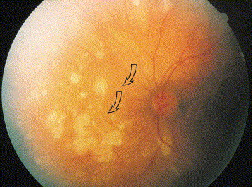
PIOL may preceed PCNSL
Ocular symptoms may preeced PCNSL in 20% of patients
Uveitis, Vitritis, floaters, ocular pain
PIOL may involve the retina, the vitreous chamber and/or the optic nerve
Diagnosis may be challenging due to the lack of viable tissue
Flow Cytometry
IHC
Biopsy

Slide 5
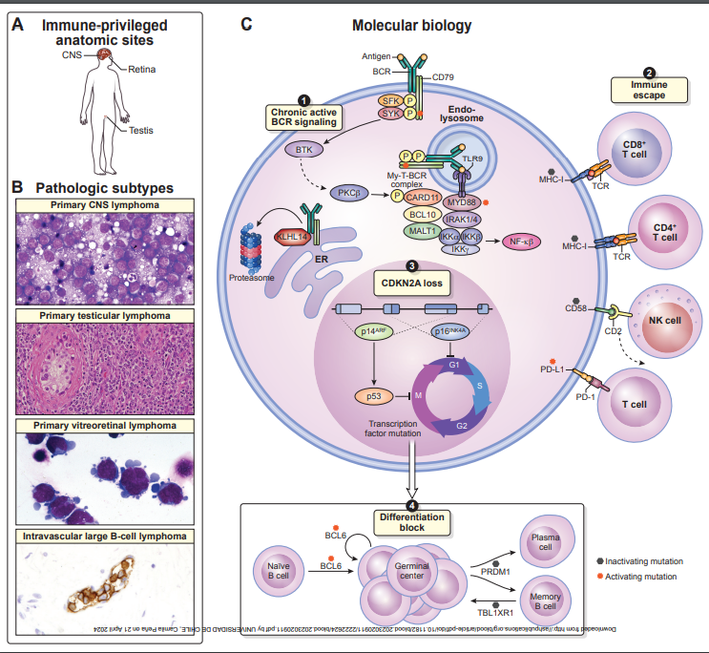

Slide 6
PCNSL Treatment
Calimeri et al, ESMO 2021

Slide 7
PCNSL Induction Therapy
MTx is the backbone of Induction Therapy
>3g/m²
2 – 4 hour infusion
Polichemotherapy is superior to MTx Alone as Induction Therapy
Modern therapy of PCNSL includes an alkylating agent in Induction

Slide 8
PCNSL Induction Therapy
Procarbazine
R-MPV followed by WBRT + Cytarabine
3y-PFS 51%
5y-OS 70%
Temozolomide
MTR followed by EA Consolidation
4y-PFS 48%
4y-OS 65%
Thiotepa
MATRIX followed by ASCT
2y-PFS 61%
2y-OS 67%
Induction Therapy should Include Methotrexate + Alkylating agent + Rituximab (+/- Cytarabine)
In Brazil, Temozolomide is more feasible
However, controversies remain...
Morris PG et al, JCO 2013
Rubenstein JL et al, JCO 2013
Ferreri AJM et al, Lancet Hematol 2016

Slide 12
Controversy 1: Rituximab
HOVON105/ALLG NHL24
Phase 3 of MBVP +/- Rituximab followed by Cytarabine and WBRT (<60y)
No difference in ORR, EFS, PFS and OS
No toxicity signal
Rituximab did not improve results in a phase 3 trial
However...
There is a sign of better results in pts <60y
Not toxic
If resources not a problem, should be offered as part of induction regimen
Bromberg JEC et al, Lancet Hematol 2019

Slide 13
Controversy 2: IT/IO Chemo
Remains a matter of debate
PCNSL SG1 proposed CSF dissemination as a poor prognosis
Recent trials does not include IT/IO Treatment
Not recommended by most Guidelines
Can be an alternative in patients receiving MTx<3g/m2
Preferably Intraventricular route (Omaya reservoir)
Hoang-Xuan K, Lancet Hematol 2015

Slide 14
Consolidation Strategies 1: WBRT
Prefered Consolidation for the last 40y
PFS benefit proved in the highly controversial PCNSL SG-1 trial
No OS Benefit
Toxic!
Thiel E, Lancet Oncol 2010

Slide 15
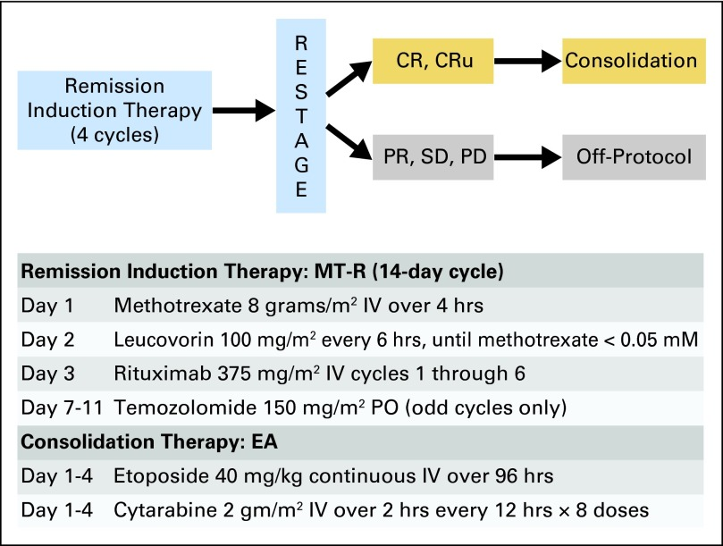
Consolidation Strategies 2: Chemo
Non-myeloablative chemotherapy is an option (Alliance 50202)
EA Consolidation most acceptable
Rubenstein et al, JCO 2014

Slide 16
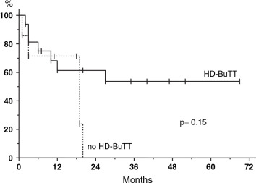
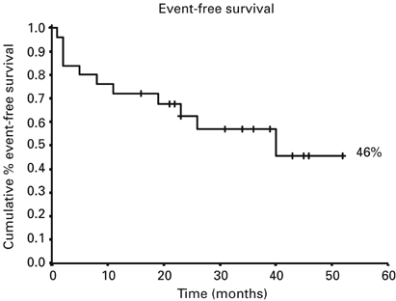
Consolidation Strategy 3: ASCT
Illerhaus
(n=79)
ASCT (BCNU+TT) after R-Mtx (8) + R-Cy(3)
5y-PFS 64.8%
5y-OS 79%
GOELAMS
(n=25)
ASCT (BEAM)
High number of relapses after ASCT
4y-PFS 46%
4y-OS 64%
OSHO-53
(n=16)
ASCT (BuTT)
2y-EFS 56%
2y-OS 61%
Illerhaus G et al, Lancet Hematol 2016
Colombat et al, BMT 2006
Montemurro M et al, Ann Oncol 2007

Slide 17
Is there a better Consolidation?
Phase 2 PRECIS trial
18 – 60 y/o (n=140)
Randomized 1:1 to WBRT or ASCT (TBC)
11% deaths related to ASCT
No 4y-OS benefit (64 x 66%)
IELSG32 – 2nd Randomization
18 – 70 y/o (n=118)
Randomized 1:1 to WBRT or ASCT (TT + BCNU)
No PFS Benefit
No OS Benefit
ASCT is at least equivalente to WBRT as consolidation:
Improvement in neurocognition
No long term toxicities
However, not all patients are suitable to ASCT
Mobilization
Conditioning regimen toxicity
Tiothepa in Brazil is challenging...
There is no room for BEAM conditioning in PCNSL
ASCT will be compared to chemotherapy (R-DeVic) in a ph3 trial (NCT02531841)
Houillier C et al, JCO 2018
Ferreri AJM et al, Lancet Hematol 2017

Slide 18
ASCT in PCNSL
Ilerhaus, Lancet Hematol 2016 (n=81)
Conditioning Regimen
Rituximab 375mg/m2 D-7
Carmustina 400mg/m2 D-6
Tiotepa 5mg/kg D-5, D-4
Infusão D0
Pegfilgatrim D4
Ilerhaus et al, Lancet Hematol 2016

Slide 19
Toxicidade do Tratamento
Ilerhaus et al, Lancet Hematol 2016

Slide 20
ASCT in PCNSL - MATRIX
Ferreri et al, Lancet Hematol 2017
Condicionamento:
Carmustina 400 mg/m² on day –6
Thiotepa 5 mg/kg every 12 h on days –5 and –4
N=54
Ferreri et al, Lancet Hematol 2017

Slide 21
Toxicidade
Ferreri et al, Lancet Hematol 2017

Slide 22
ASCT in PCNSL – ANOCEF/GOELAMS
Houssein, JCO 2019
N=70
Condicionamento:
Thiotepa (250 mg/m2 /d D-9;D-8;D-7
Busulfan 8 mg/kg [total dose] D-6 a D4
Cyclophosphamide 60 mg/kg/d D-3 e D2
Peg-filgrastim on D3.

Slide 23
Toxicidade
Houssein, JCO 2019

Slide 24
658 Radiotherapy (WBRT) or Autologous Stem-Cell Transplantation (ASCT) for Primary CNS Lymphoma in Patients 60 Years of Age and Younger: Long-Term Results of the Intergroup Anocef-Goelams Randomized Phase II Precis Study

Slide 26
Consolidation Therapy – My POV
ASCT for elegible, responding Young patients
EA Consolidation for all others
WBRT only for a minority of young patients not suitable for other strategies
E.g.: PTLC-CNS
Perini GF et al, Blood (2015) 126 (23): 3913

Slide 27
What IC should we use?
BCNU/TT looks like a better option in Brazil
Less Toxicity
Cheaper
BuCyTT more toxic, although may have superior disease control in retrospective data
No Room for BEAM
Transplant should be performed in experienced sites

Slide 28
Conclusions
Primary CNS lymphomas are rare, hard to treat lymphomas
Treatment still relies on chemotherapy
Role of ASCT in Young patients
Beware of toxicities
New agents have yet to be incorporated in managing PCNSL
BTKi
Len
CPI

Slide 29
¿ Porque tenemos, como GELL, que estudiar los Linfomas Primarios de SNC?

Slide 30
GELL e PCNSL
Porque son Linfomas raros, con pocos datos del mundo real
Porque tenemos pocos o ningún dato en los países en desarrollo
Porque tenemos características clínicas peculiares en nuestra región
Porque nuestra realidad de acceso a nuevas terapias es muy diferente

Slide 31
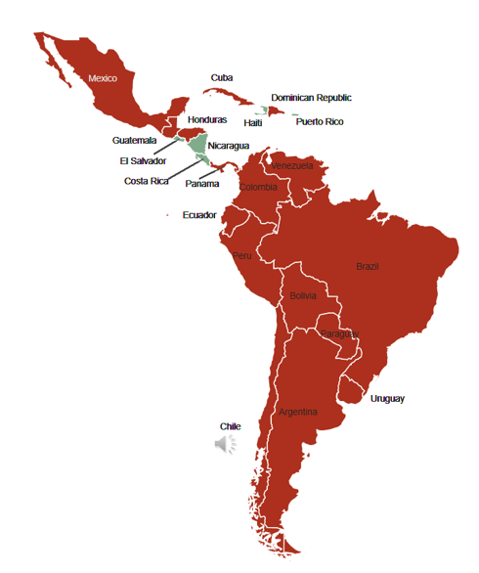
GELL Survey
A total of 90 surveys were completed from 80 cancer centers in LATAM
Most centers treat up to 5 new cases of PCNSL/year (84%), with only 3 centers treating more than 15 cases/year. The median time for treatment initiation was 0-10 days in 36%, 10-20 days in 37% and >30 days in 26% of the centers.

Slide 32
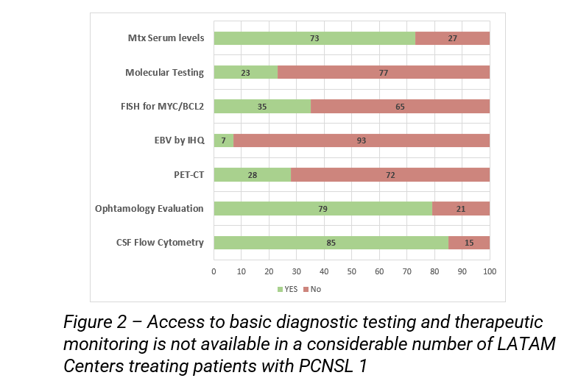
GELL Survey

Slide 33
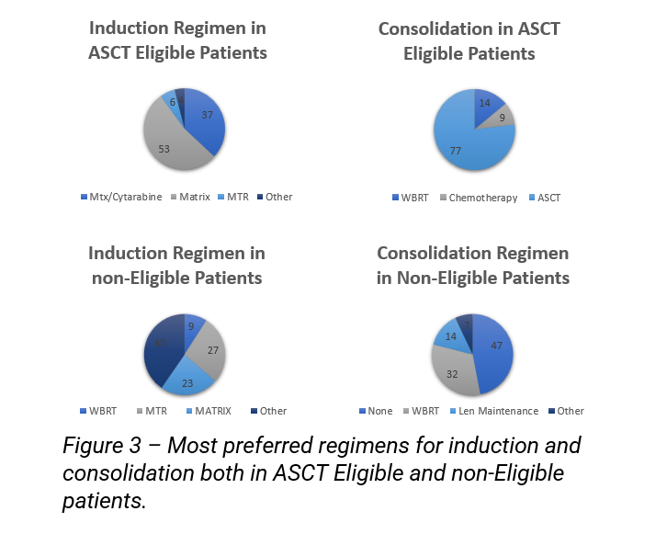
GELL Survey

Slide 34
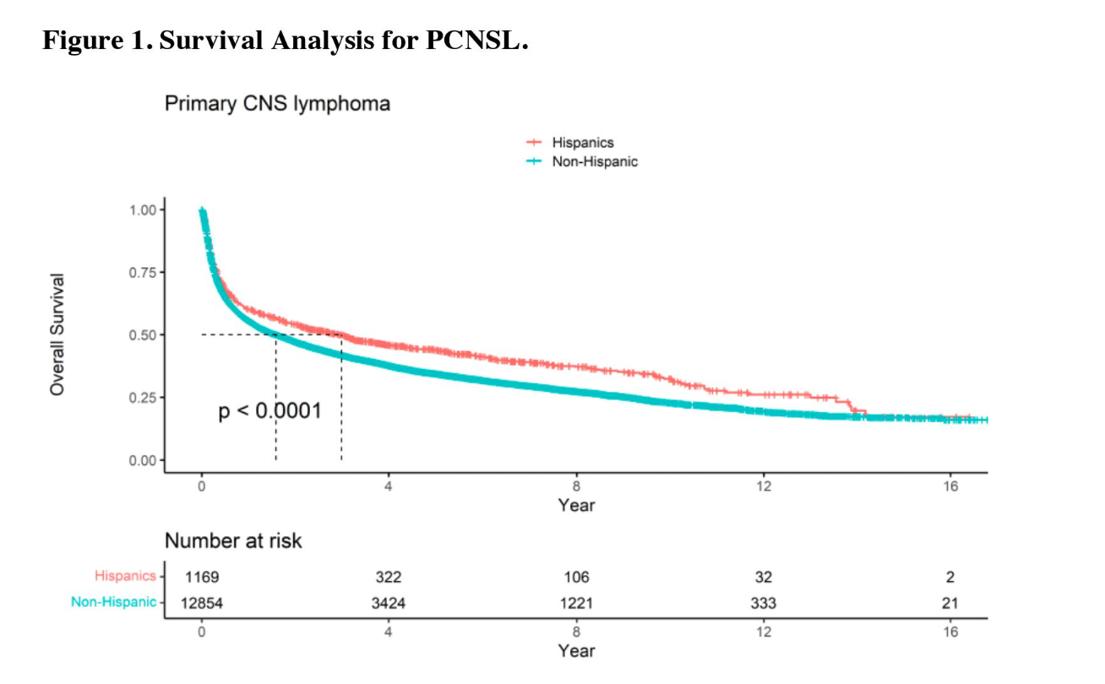

Slide 35
Sugerencia de estudios em PCNSL
Estudo retrospectivo de PNCSL e tambien de compromiso secundário de SNC
Utilizar la estrutura ELLA
Un protocol específico?

Slide 36
Sugerencia de estudios em PCNSL
Estudo prospectivo de PNCSL
Oportunidades de Aporte:
BMS (Golcadomida)
Alguna farma con un iBTK (AZ, Janssen, Beigene)
Dr. Reddys (BCNU)

Slide 37
Sugerencia de estudios em PCNSL
Algun Estudio de tratamento prospectivo
Terapias non son caras
Por Ejemplo:
Induccion: MTx 5g/m2 + Alquilante
Consolidacion: 3-4 Ciclos de ICE
Como hacer esto?
Creo que ahora tenemos que centrarnos en comprender las leyes y regulaciones nacionales para poder realizar estudios prospectivos.

Slide 38
“Si quieres ir rápido, ve solo. Si quieres llegar lejos, acompañado”
guilherme.perini@einstein.br
@guiperiniMD

