Slide 1
Linfoma de células T/NK Extranodal: perfiles moleculares y posibles nuevos blancos terapéuticos
Raúl Córdoba Mascuñano
Unidad de Linfomas – Servicio de Hematología
5 octubre 2024

Slide 2
Conflictos de interés
Consultoría: Roche, Abbvie, Johnson & Johnson, Beigene, Astra Zeneca, Incyte, Takeda, Kyowa-Kirin, Gilead, Regeneron, Lilly
Ponencias: Roche, Abbvie, Johnson & Johnson, Beigene, Astra Zeneca, Incyte, Takeda, Kyowa-Kirin, Gilead, Lilly

Slide 3
Introduction
Extranodal natural killer/T-cell lymphoma, nasal type (ENKTL-NT), is an aggressive lymphoma characterized by its universal association with Epstein–Barr virus (EBV).
It typically affects the nasal/oropharyngeal area, although in some patients, involves other extranodal sites.
ENKTL-NT has a distinct geographical distribution, occurring more commonly in East Asia and Latin America than in North America and Europe, where it is a rare disease.¹
The prognosis is extremely poor under conventional anthracycline-based chemotherapy.
Drugs that are generally unaffected by multidrug resistance pathways, such as L-asparaginase-based regimens, have yielded better responses, and the prognosis of these patients has improved in the last years, although survival is still poor compared to other lymphomas.
For this reason, there is an urgent need for effective therapy.
In recent years, novel molecular analysis and genomic profiling studies have contributed to the understanding of the molecular biology of ENKTL-NT. However, most of the clinical and biological data published come from East Asian and Latin American series of cases, and their results have not been reproduced in western populations.
Gonzalez Barca E, et al. Am J Hematol. 2023 Jun;98(6):E134-E138.

Slide 4
Methods
The objective of this retrospective study is to analyze the clinical characteristics and outcomes of 89 patients with ENKTL-NT in a western population from Spain and to perform gene expression profiling (GEP) and mutational profiling to characterize new biomarkers and identify new targets for therapy.
Thirty-seven cases with appropriate formalin-fixed paraffin-embedded tumor samples from diagnosis, rich in EBV-positive tumor cells, were used for biological studies.
A consensus diagnosis was made by two expert hematopathologists in accordance with the 2017 World Health Organization Guidelines.
Gonzalez Barca E, et al. Am J Hematol. 2023 Jun;98(6):E134-E138.

Slide 5
Patients characteristics
Gonzalez Barca E, et al. Am J Hematol. 2023 Jun;98(6):E134-E138.

Slide 6
Patients characteristics
Gonzalez Barca E, et al. Am J Hematol. 2023 Jun;98(6):E134-E138.

Slide 7
Patients characteristics
Gonzalez Barca E, et al. Am J Hematol. 2023 Jun;98(6):E134-E138.

Slide 8
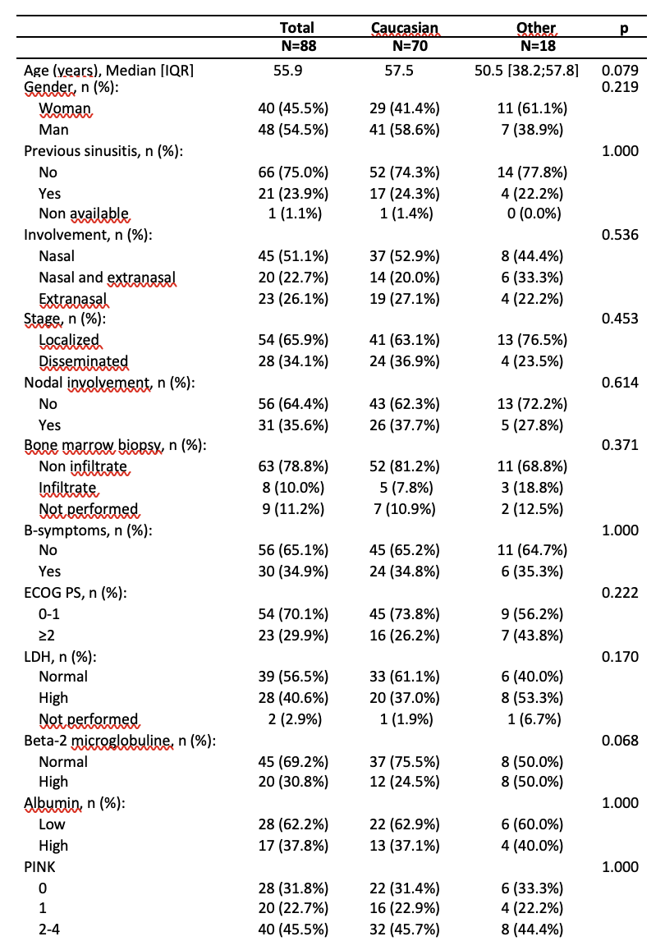
Clinical characteristics at diagnosis according to ethnicity
Gonzalez Barca E, et al. Am J Hematol. 2023 Jun;98(6):E134-E138.

Slide 9
First line treatment and response rate of patients according to ethnicity
Gonzalez Barca E, et al. Am J Hematol. 2023 Jun;98(6):E134-E138.

Slide 10
Overall survival (OS) of the global series of 89 patients,
With a median follow-up of 3.9 (95% confidence interval [CI], 3.2–7) years, 3-year overall survival (OS) was 40% (95% CI, 30%–52%), and 3-year progression-free survival (PFS) 34% (95% CI, 25%–47%).
Gonzalez Barca E, et al. Am J Hematol. 2023 Jun;98(6):E134-E138.

Slide 11
OS according to the Prognostic Index for Natural Killer Lymphoma (PINK)
Gonzalez Barca E, et al. Am J Hematol. 2023 Jun;98(6):E134-E138.

Slide 12
OS according to the first line of treatment
Patients treated with regimens that included high-dose L-asparaginase had a 3-year OS of 59% (95% CI, 41%–86%) and 3-year PFS of 50% (95% CI, 32%–78%) compared with patients treated with CHOP/CHOP-like, whose 3-year OS was 19% (95% CI, 5–32) and 3-year PFS 19% (95% CI, 10%–40%)
Gonzalez Barca E, et al. Am J Hematol. 2023 Jun;98(6):E134-E138.

Slide 13
Distribution of mutations in the 62 analyzed genes.
Different gene expression signatures were identified in 24 patients:
cytotoxic signature (GZMA, GZMB, NKG7, PRF1)
EBV signature (LPM-1, LPM-2, BMLF1, BZLF1)
T-cell receptor signature (TCRBC1/2, TCRGC1/2)
B-cell-related genes (CD27, SPIB, MS4A1, FCRL2, CD19)
proliferation signature recognizing four coregulated genes (CDK2, E2F1, PCNA, MKi67).
Gonzalez Barca E, et al. Am J Hematol. 2023 Jun;98(6):E134-E138.

Slide 14
Most frequently pathways affected by gene mutations
Gonzalez Barca E, et al. Am J Hematol. 2023 Jun;98(6):E134-E138.

Slide 15
Enriched pathways
There was a strong expression of immune regulator genes like B2M and HLA-II and a co-regulated gene set including AKT, PI3KCA, IKBIB, MTOR, and TGFB, which revealed the increased expression of this gene pathway that associates PI3K/MTOR/AKT with NFKB and TGFB.
Results also revealed a high expression of CD274 (PDL1) and PDCD1LG2 (PDL2), variable expression of TNFRSF8 (CD30), and intense expression of CXCR4 and PIM1.
Gonzalez Barca E, et al. Am J Hematol. 2023 Jun;98(6):E134-E138.

Slide 16
Ethnicity disparities
White patients had lower expression of genes included within the immune check-point signature (p < .001), and higher expression of T-cell receptor genes (p = .02) and PI3K pathway genes (p = .004).
Likewise, white patients expressed significantly lower levels of LMP1 (EBV) (p = .04) and of TNFRSF8 (CD30) (p = .01).
Gonzalez Barca E, et al. Am J Hematol. 2023 Jun;98(6):E134-E138.

Slide 17
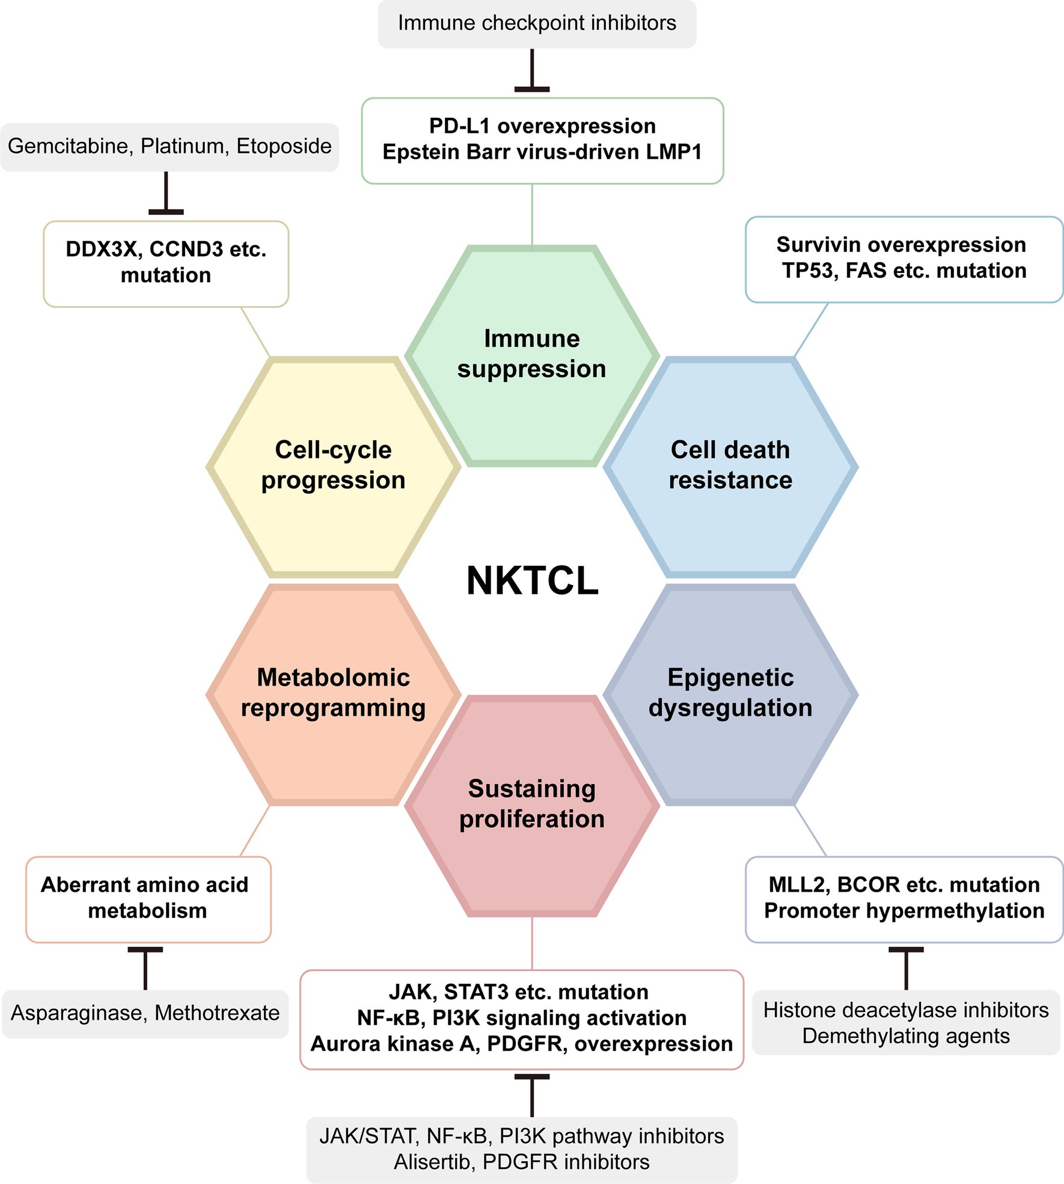
Six hallmark characteristics in the pathogenesis of NKTCL and targeted therapies.
Tian XP, et al. J Hematol Oncol. 2023 Jul 22;16(1):78.

Slide 18
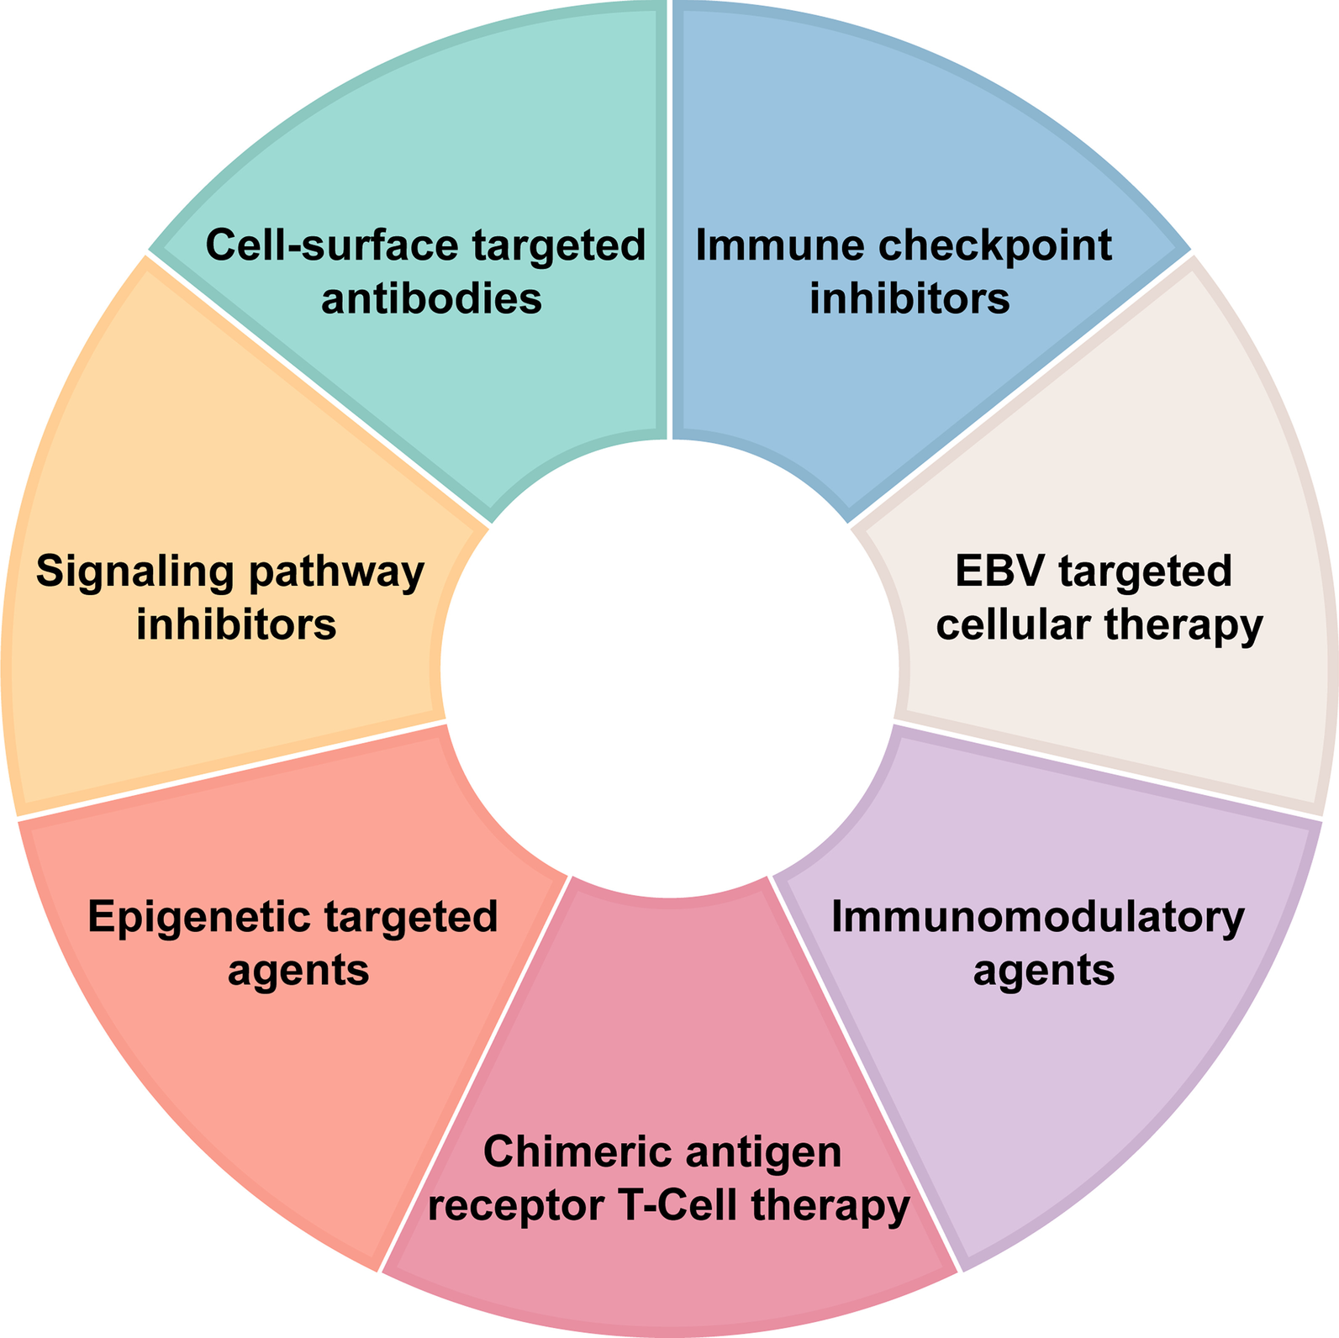
Novel target and treatment agents for natural killer/T-cell lymphoma
Tian XP, et al. J Hematol Oncol. 2023 Jul 22;16(1):78.

Slide 19
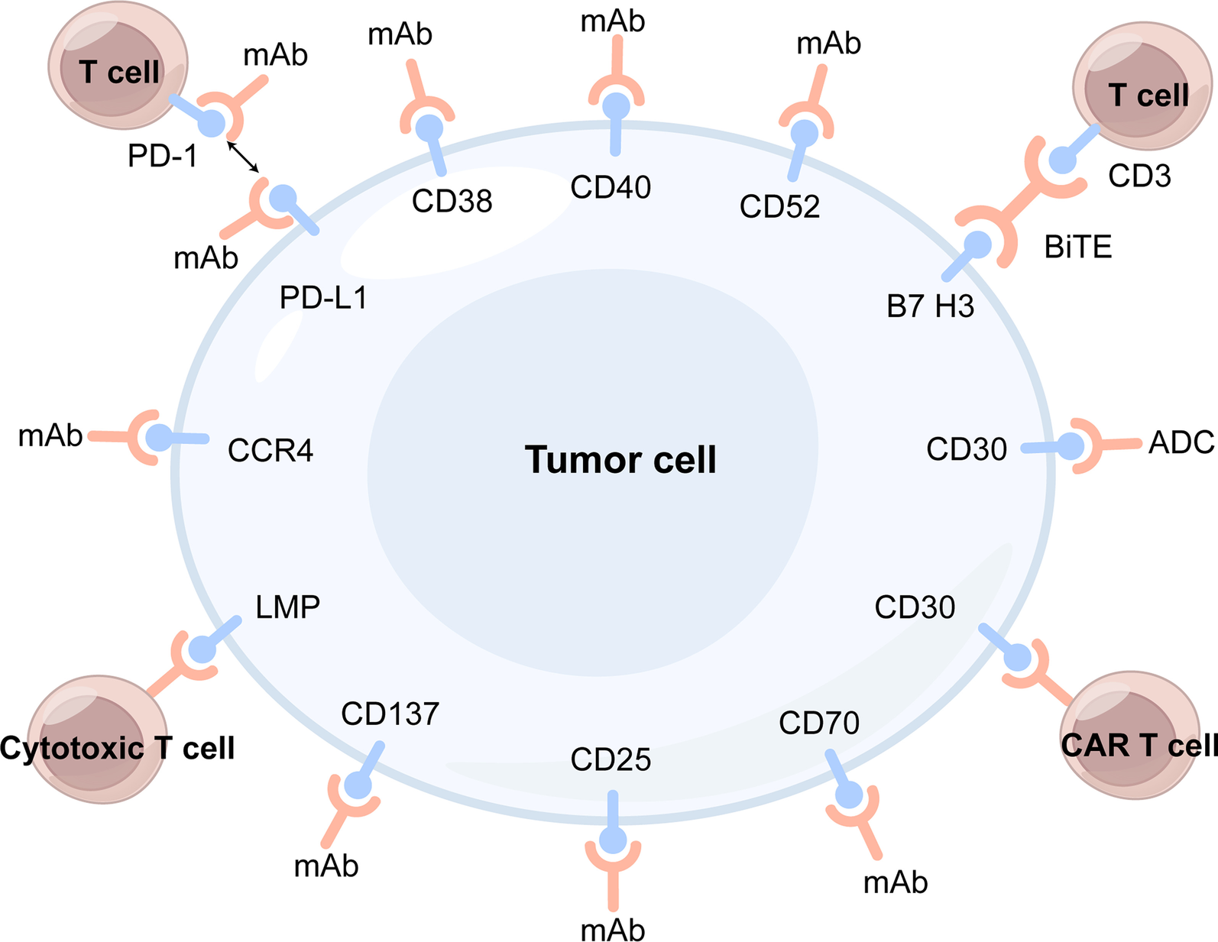
Summary of cell-surface molecules for targeted therapy in NKTCL patients
Tian XP, et al. J Hematol Oncol. 2023 Jul 22;16(1):78.

Slide 20
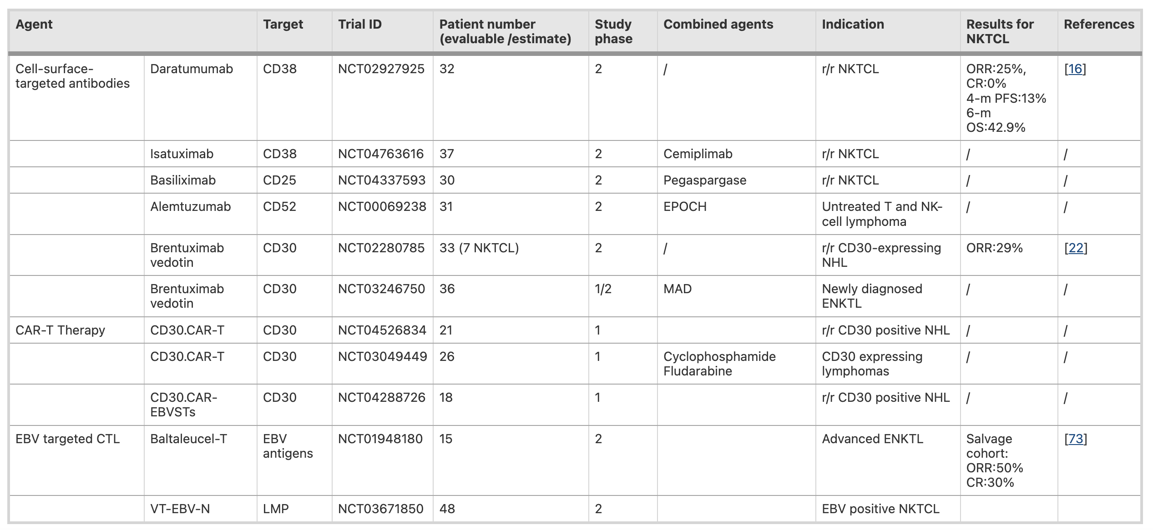
Summary of cell-surface molecules for targeted therapy and ongoing clinical trials in NKTCL patients
Tian XP, et al. J Hematol Oncol. 2023 Jul 22;16(1):78.

Slide 21
Summary of immune checkpoint inhibitors and ongoing clinical trials in NKTCL patients
Tian XP, et al. J Hematol Oncol. 2023 Jul 22;16(1):78.

Slide 22
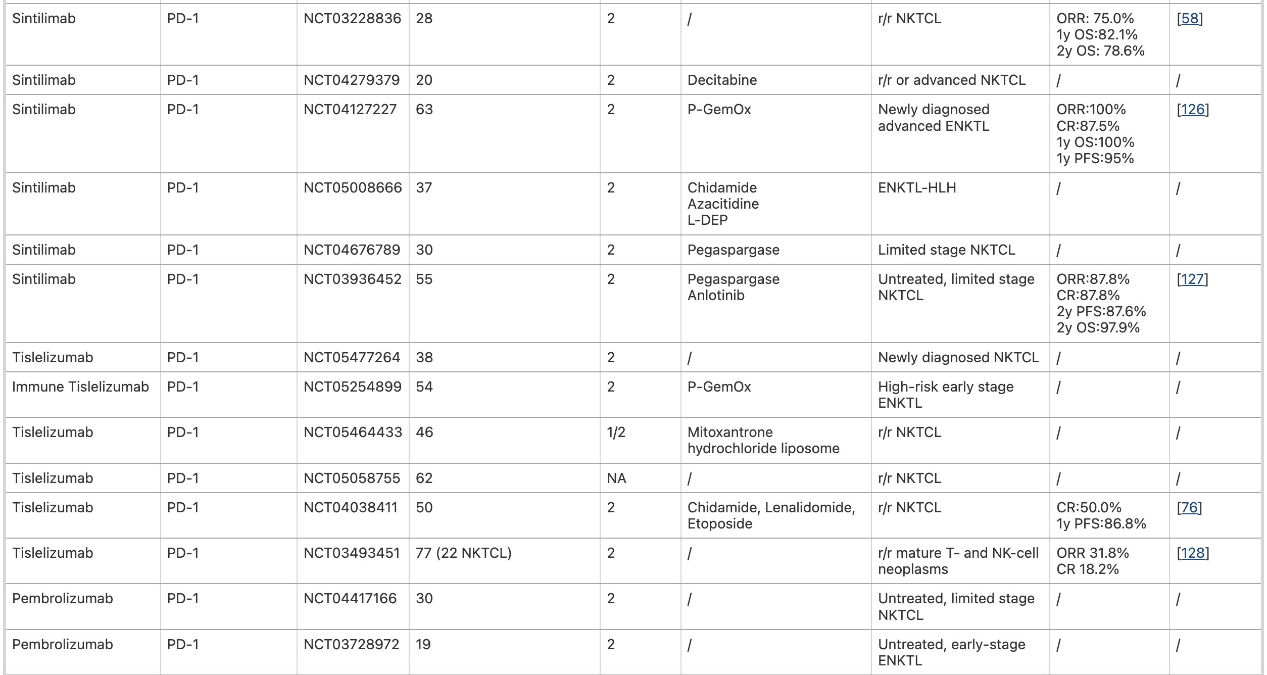
Summary of immune checkpoint inhibitors and ongoing clinical trials in NKTCL patients
Tian XP, et al. J Hematol Oncol. 2023 Jul 22;16(1):78.

Slide 23
Summary of epigenetic targeted therapy, and immunomodulatory agents and ongoing clinical trials in NKTCL patients
Tian XP, et al. J Hematol Oncol. 2023 Jul 22;16(1):78.

Slide 24
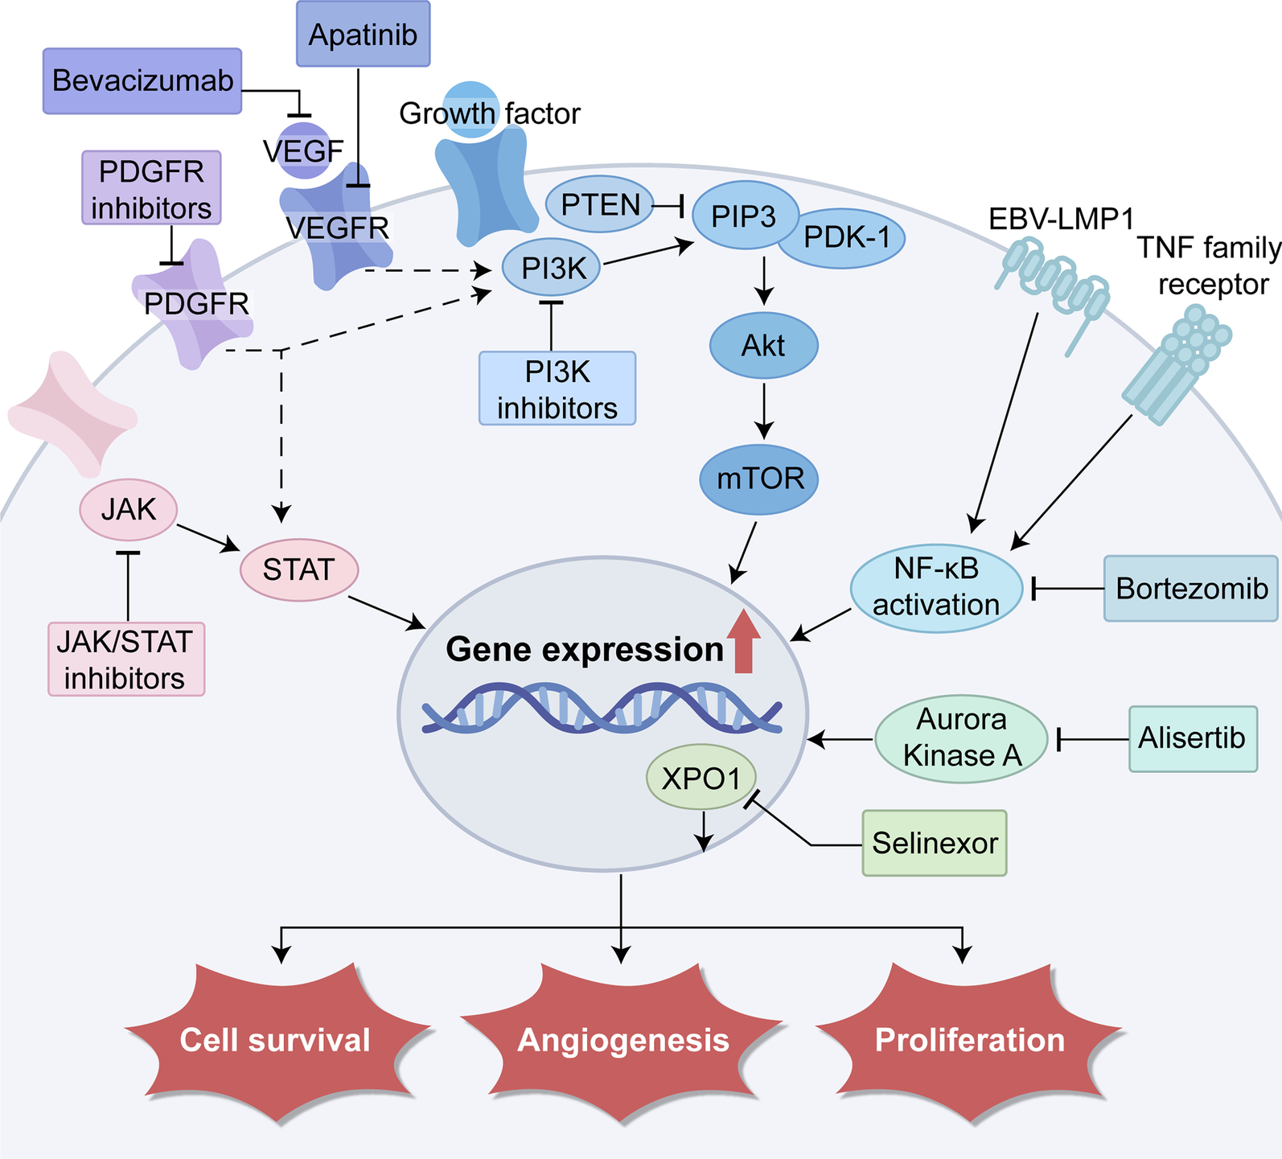
Novel agents targeting signaling pathways
Tian XP, et al. J Hematol Oncol. 2023 Jul 22;16(1):78.

Slide 25
Summary of signaling pathway inhibitors and ongoing clinical trials in NKTCL patients
Tian XP, et al. J Hematol Oncol. 2023 Jul 22;16(1):78.

Slide 26
MUCHAS GRACIAS POR SU ATENCIÓN
Raúl Córdoba Mascuñano
Email: raul.cordoba@fjd.es
X/Twitter: @DrRaulCordoba

