Slide 1

Best of EHA / ASCO 2026
Chronic Lymphocytic Leukemia

Slide 2




Best of EHA / ASCO 2026
Chronic Lymphocytic Leukemia
Celso Arrais
Disciplina de Hematologia, Hemoterapia e Terapia Celular / UNIFESP
Hospital Nove de Julho – Rede Americas

Slide 3
EHA Guidelines 2026

Slide 4
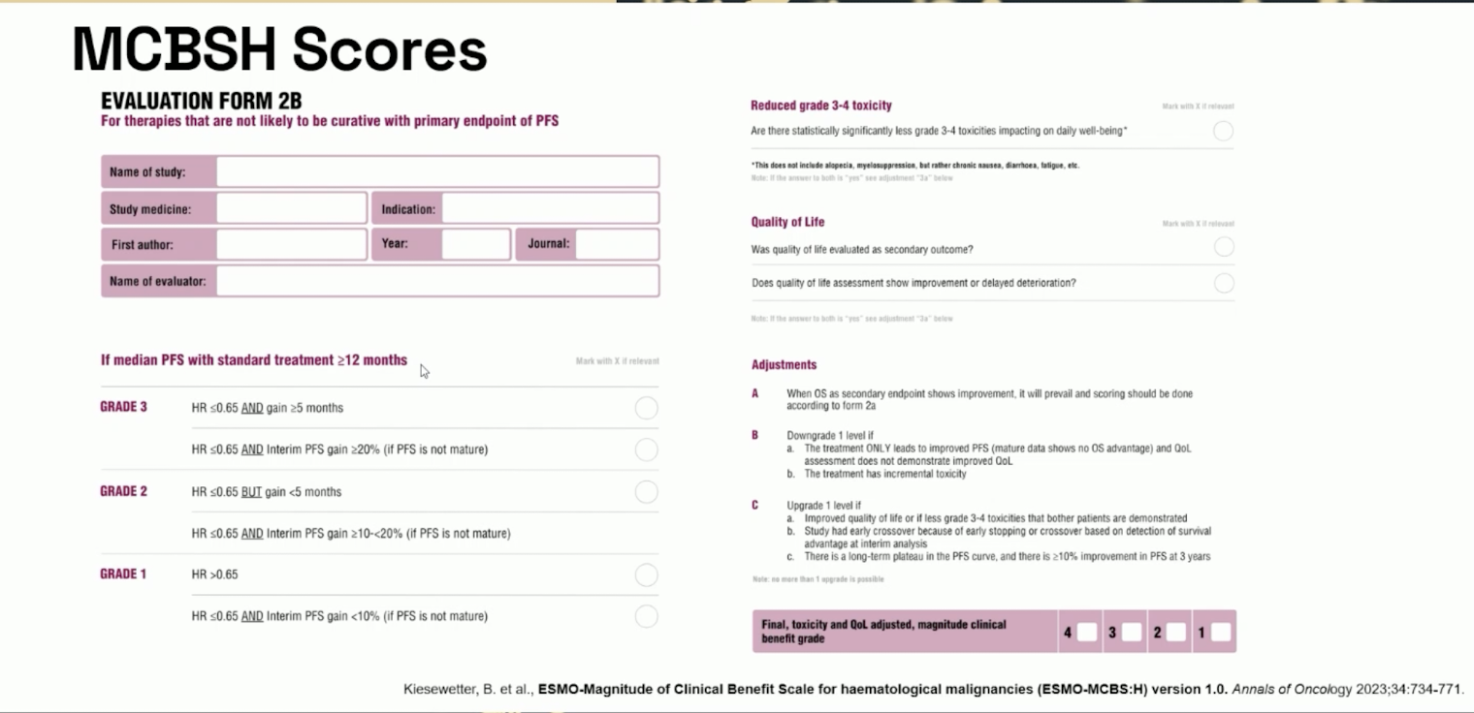

Slide 5
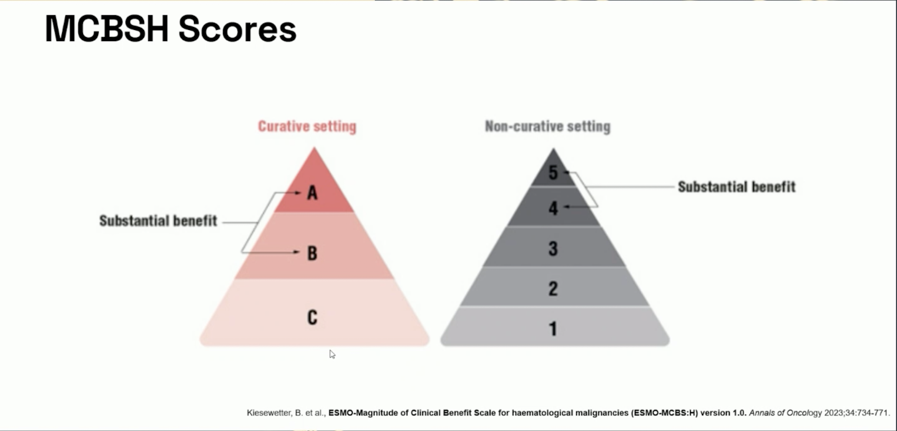

Slide 6
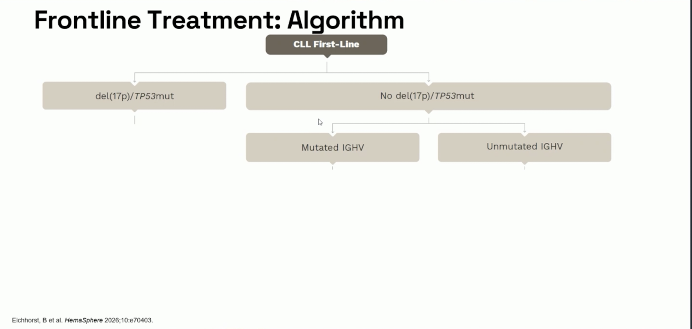

Slide 7
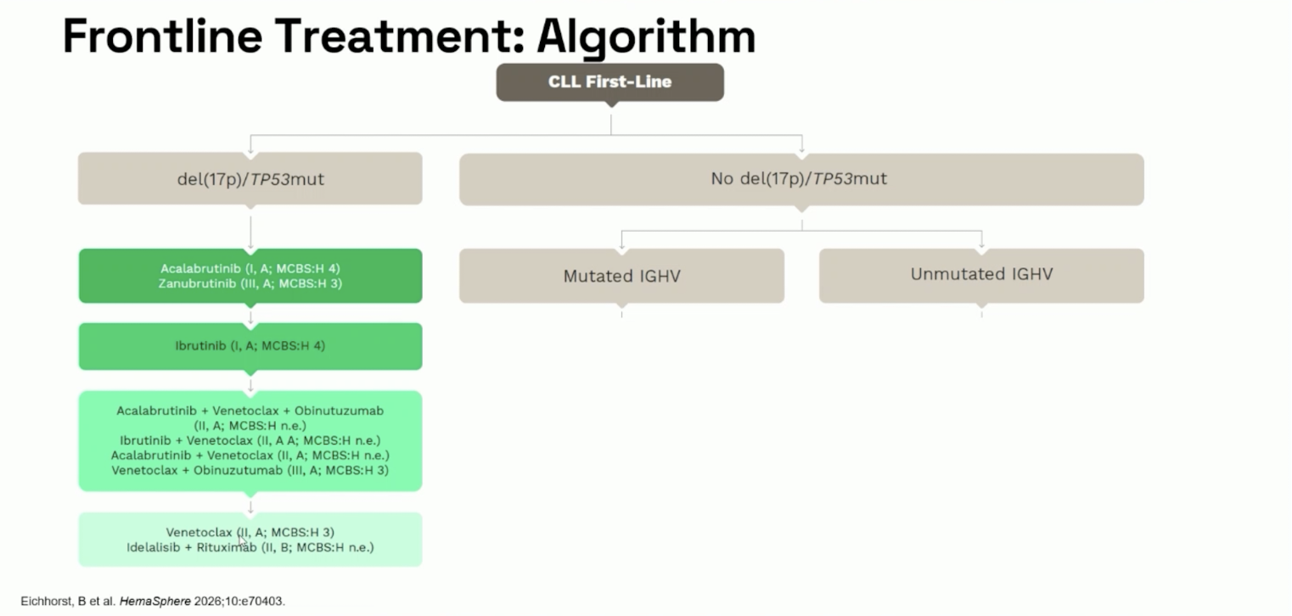

Slide 8
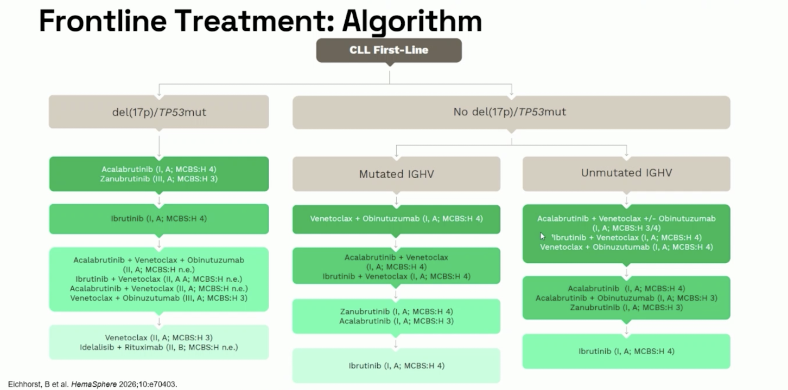

Slide 9
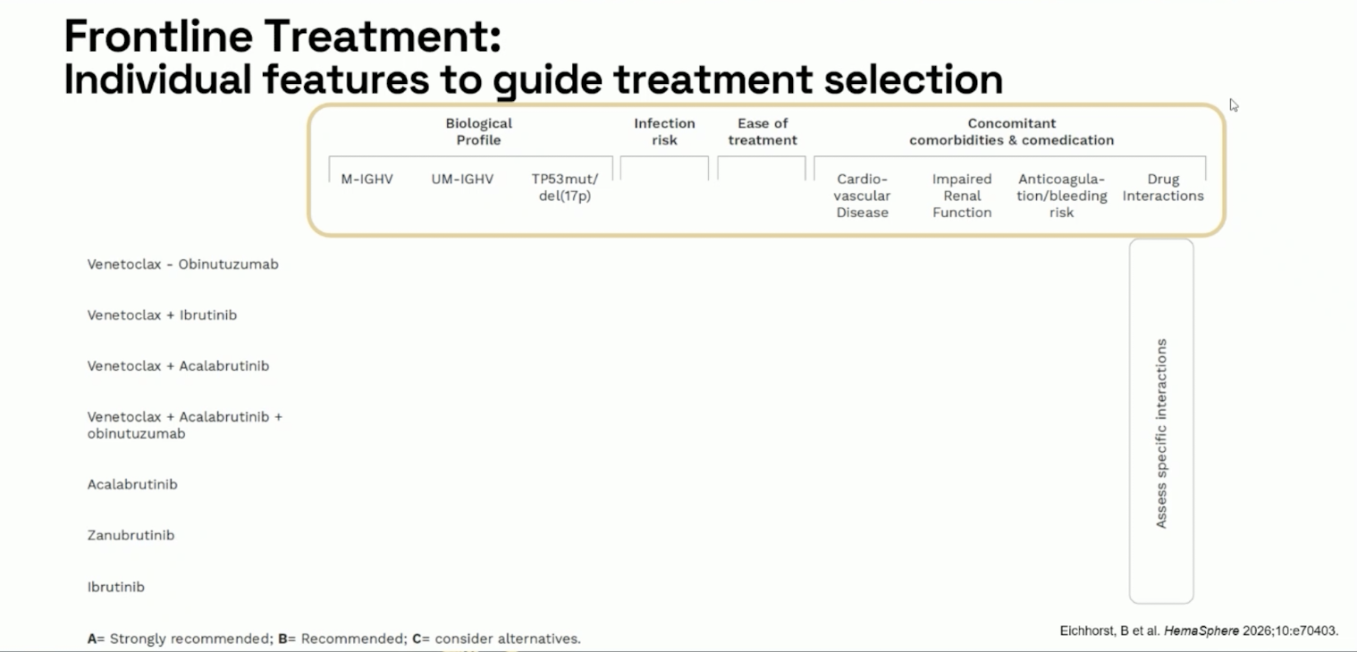

Slide 10
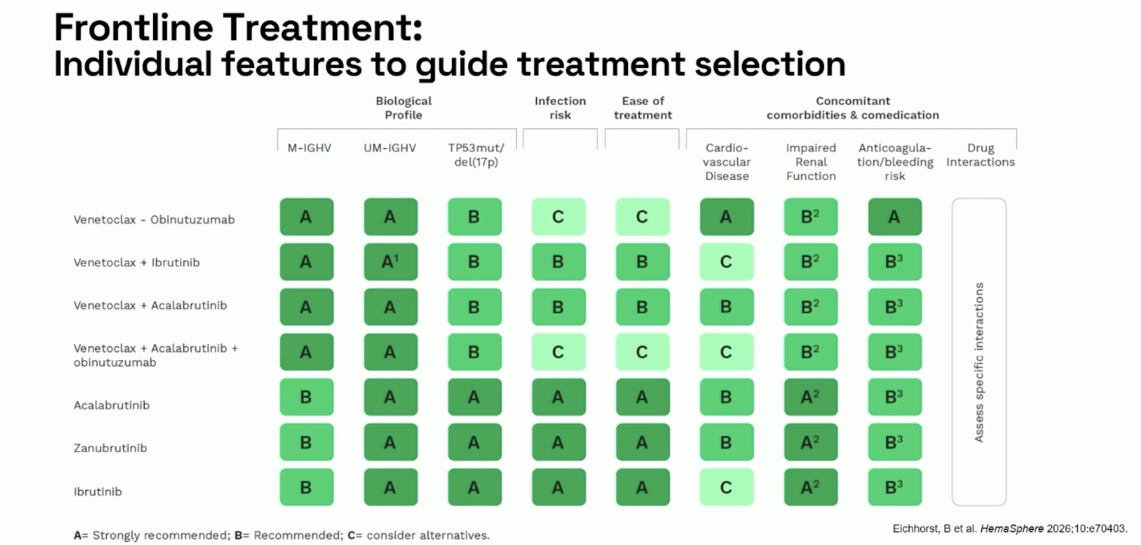

Slide 11
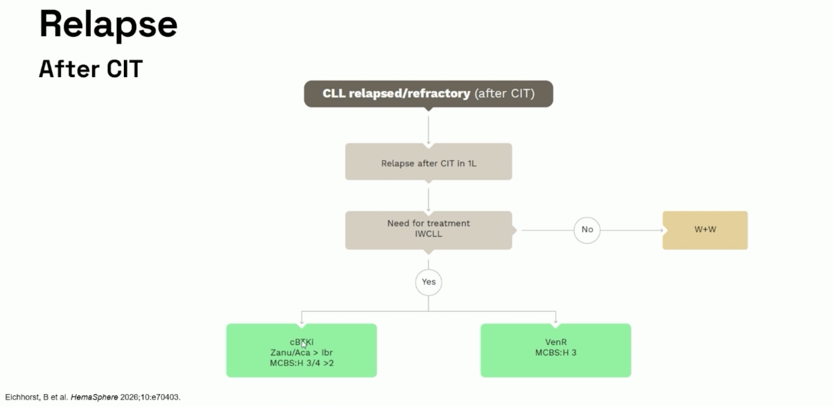

Slide 12
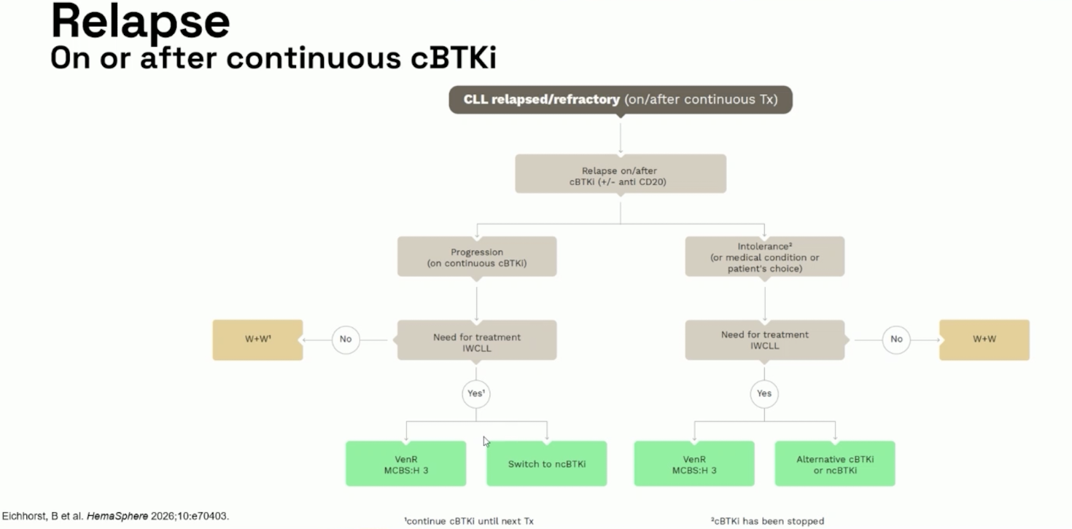

Slide 13
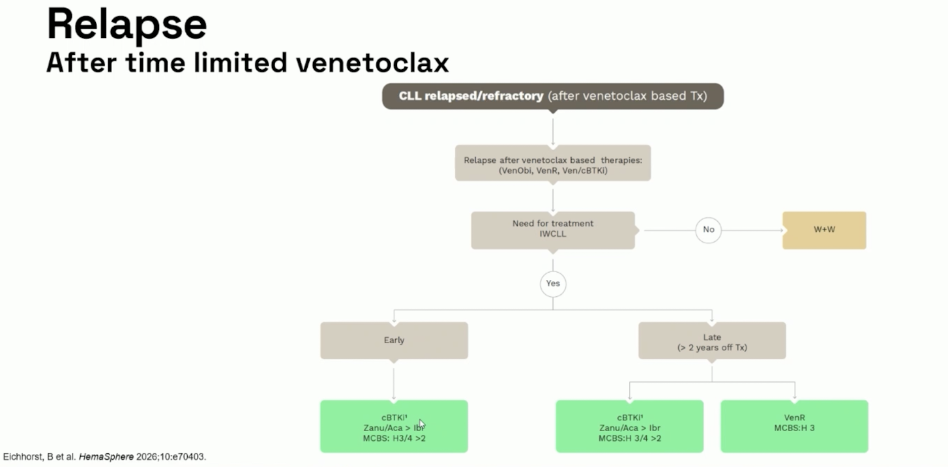

Slide 14
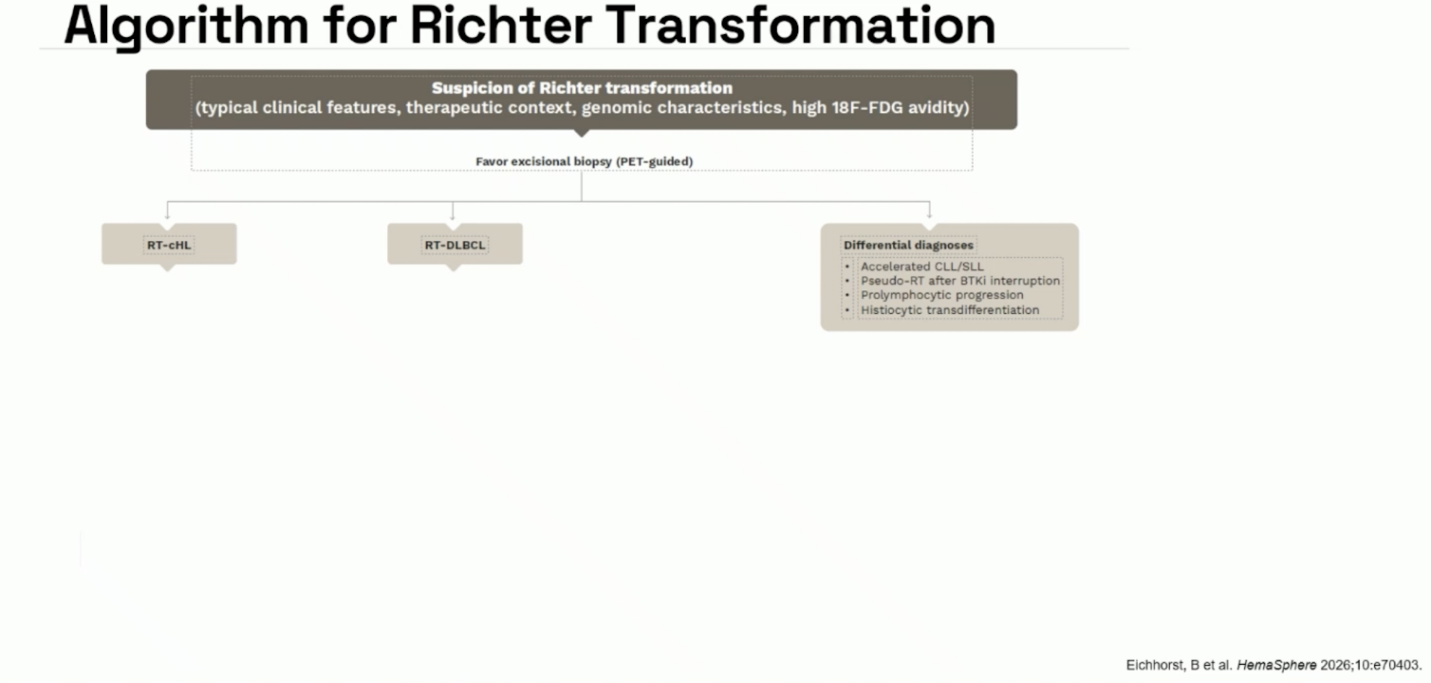

Slide 15
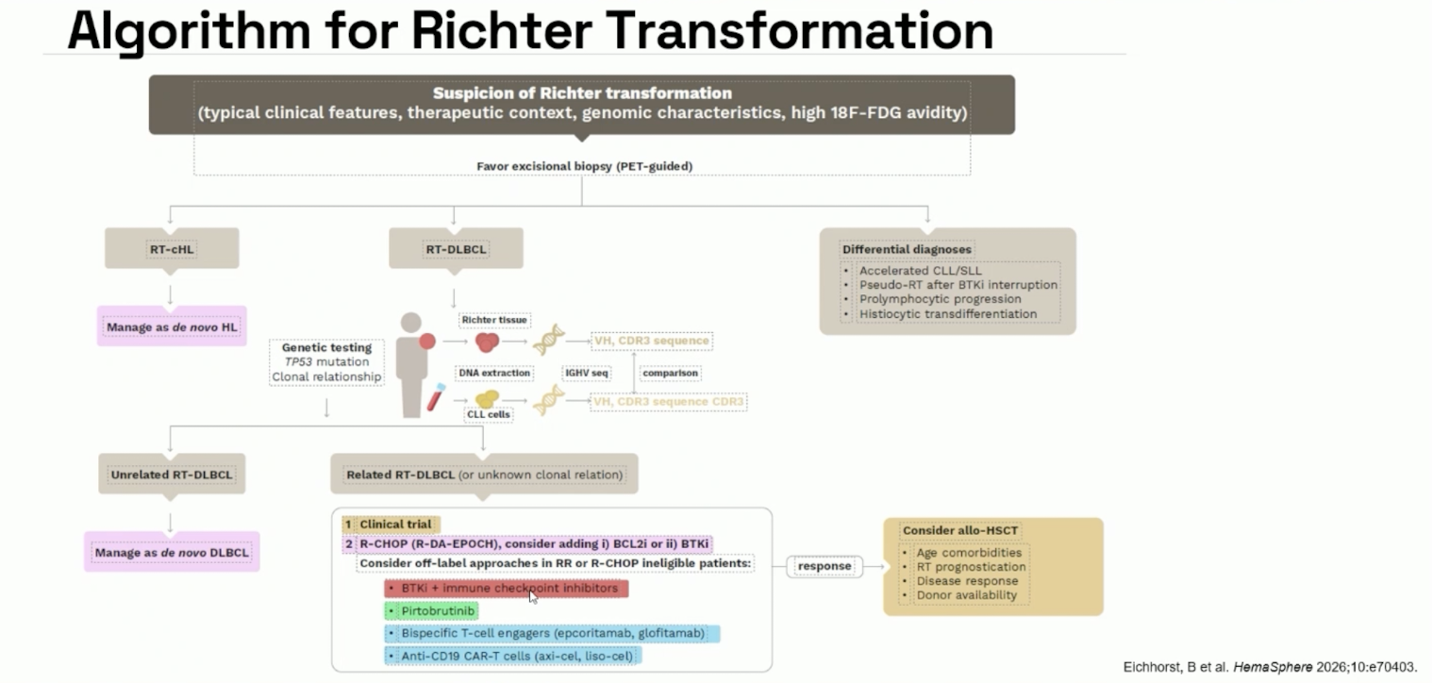

Slide 16
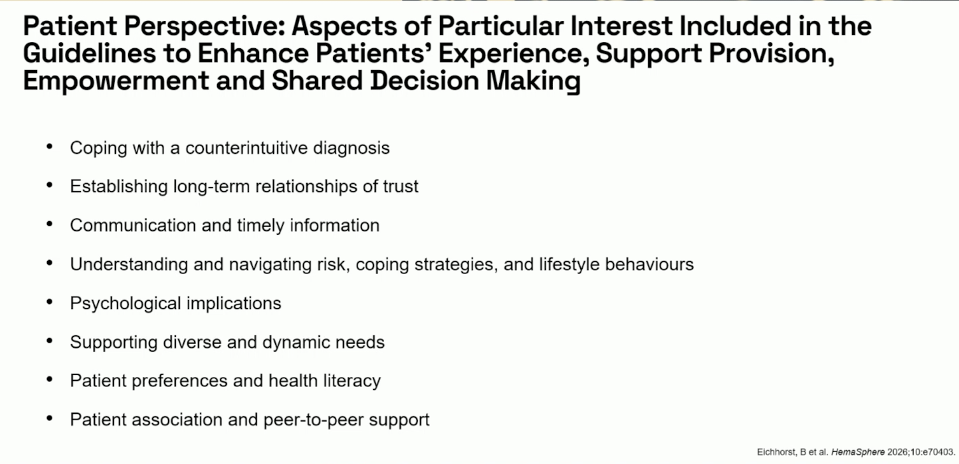

Slide 17
Oral presentations

Slide 18
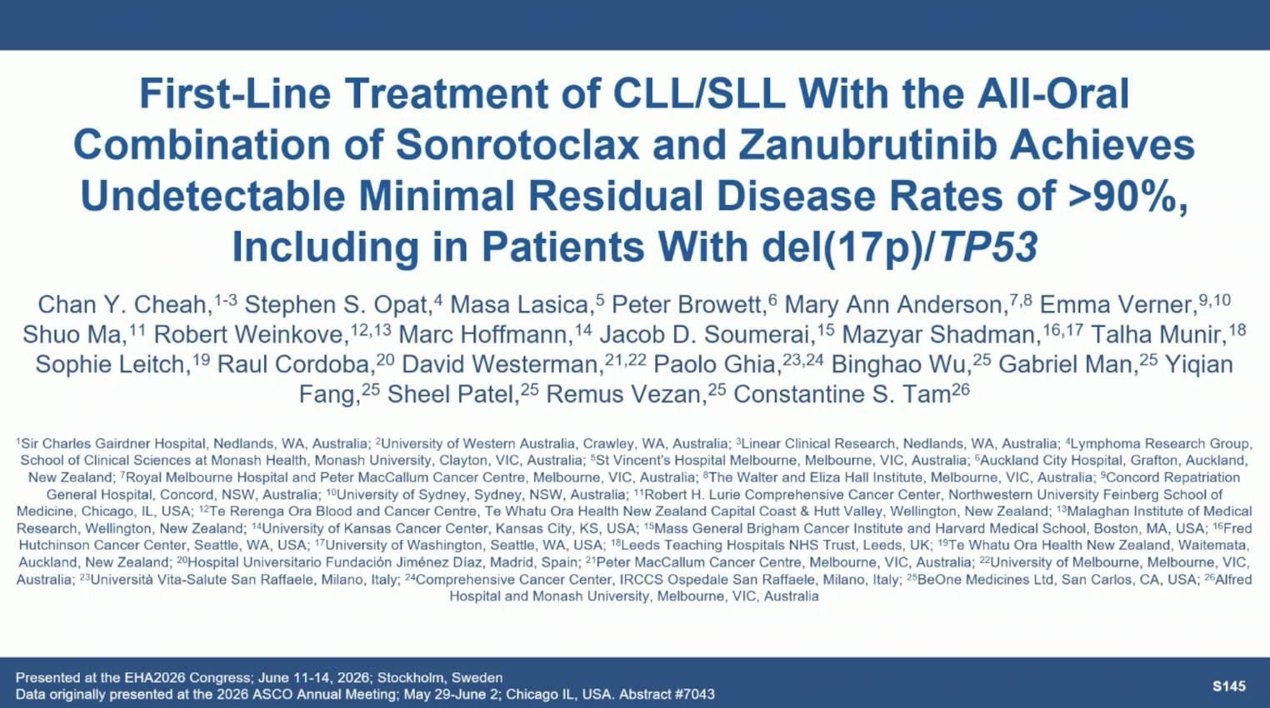

Slide 19
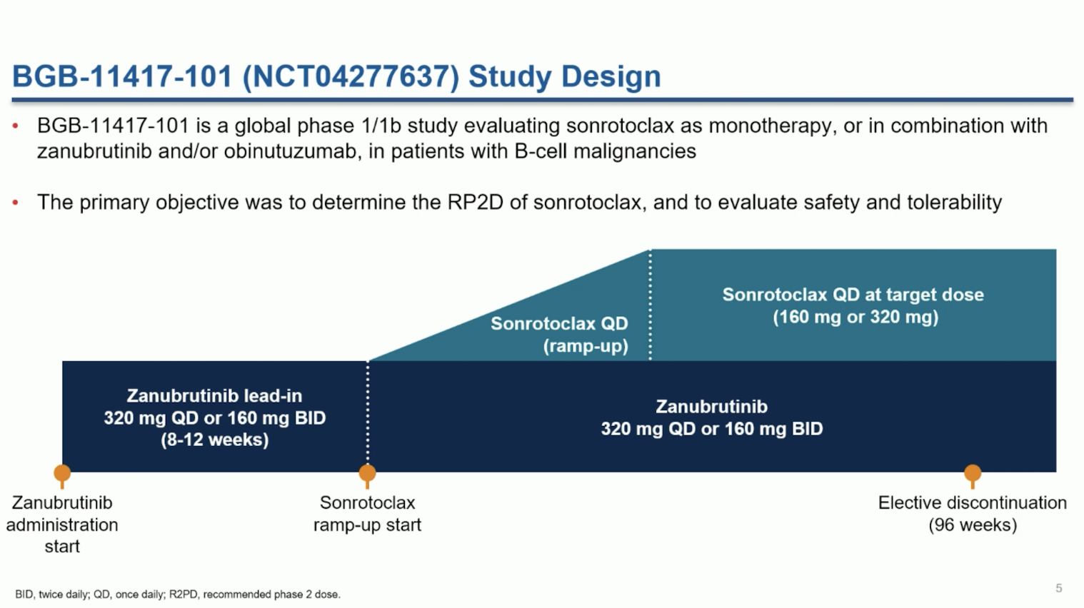

Slide 20
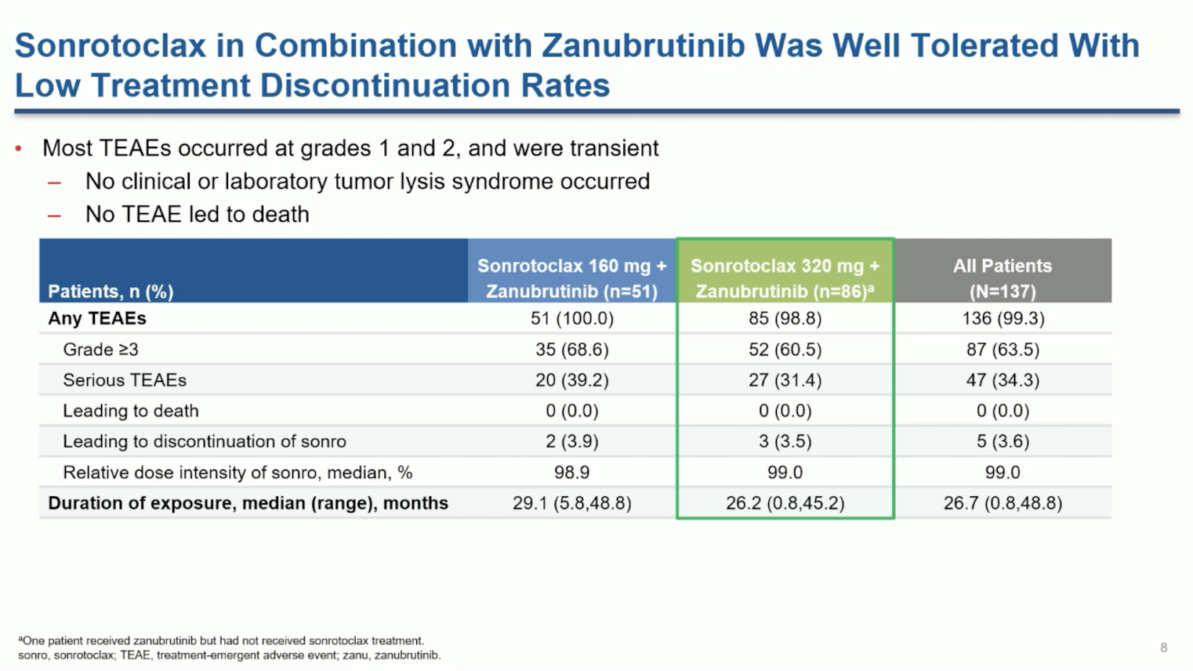

Slide 21
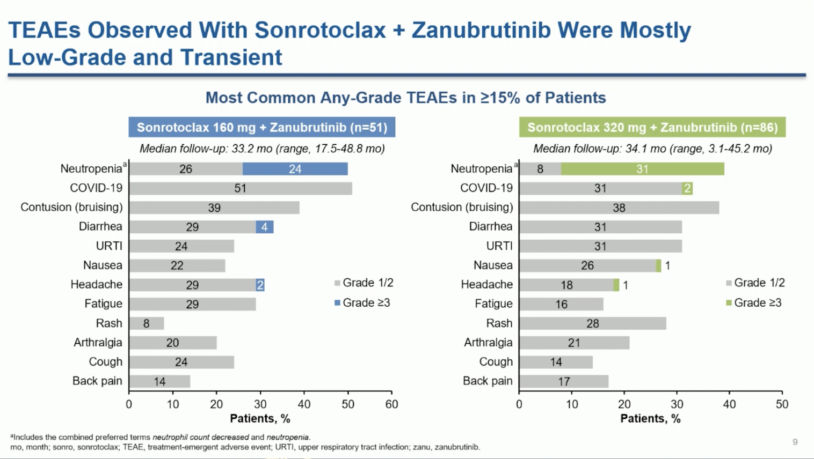

Slide 22
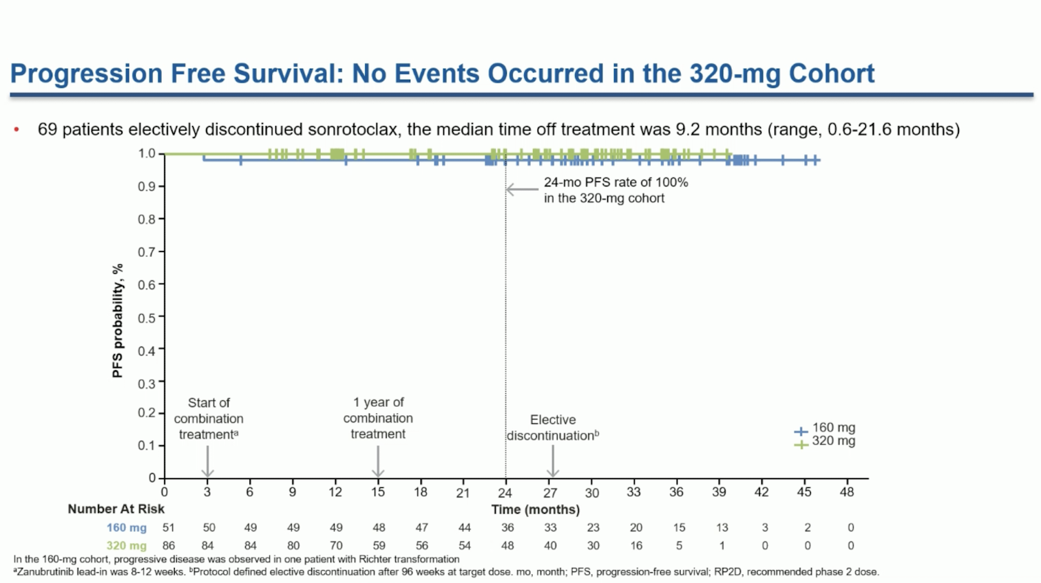

Slide 23
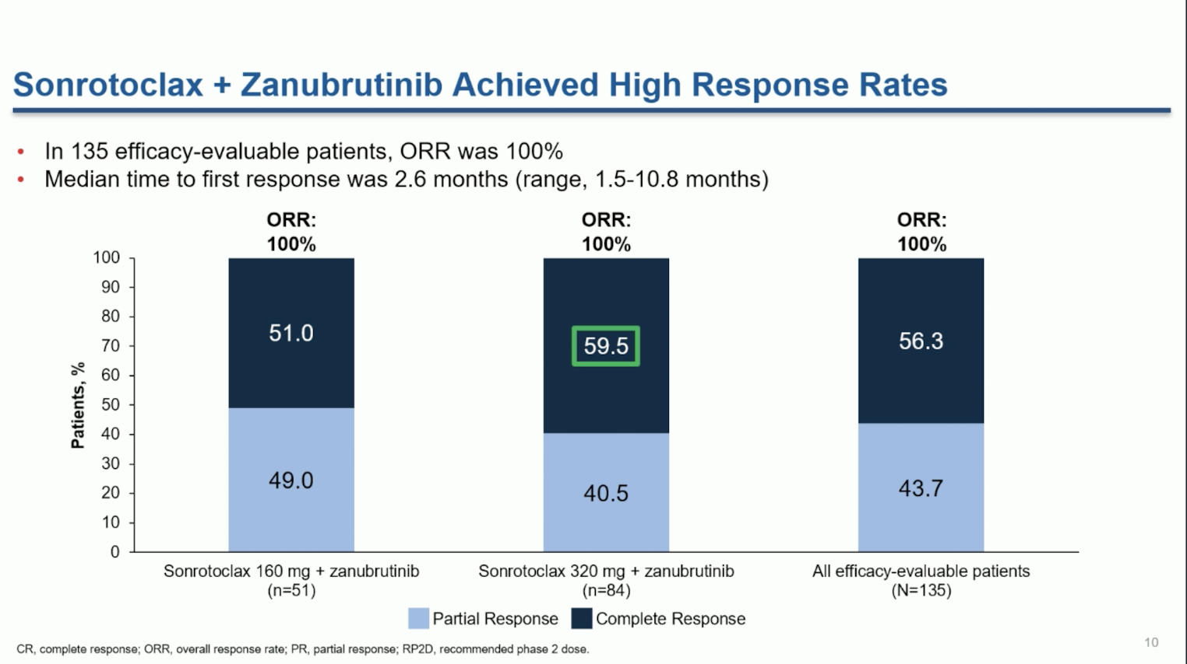

Slide 24
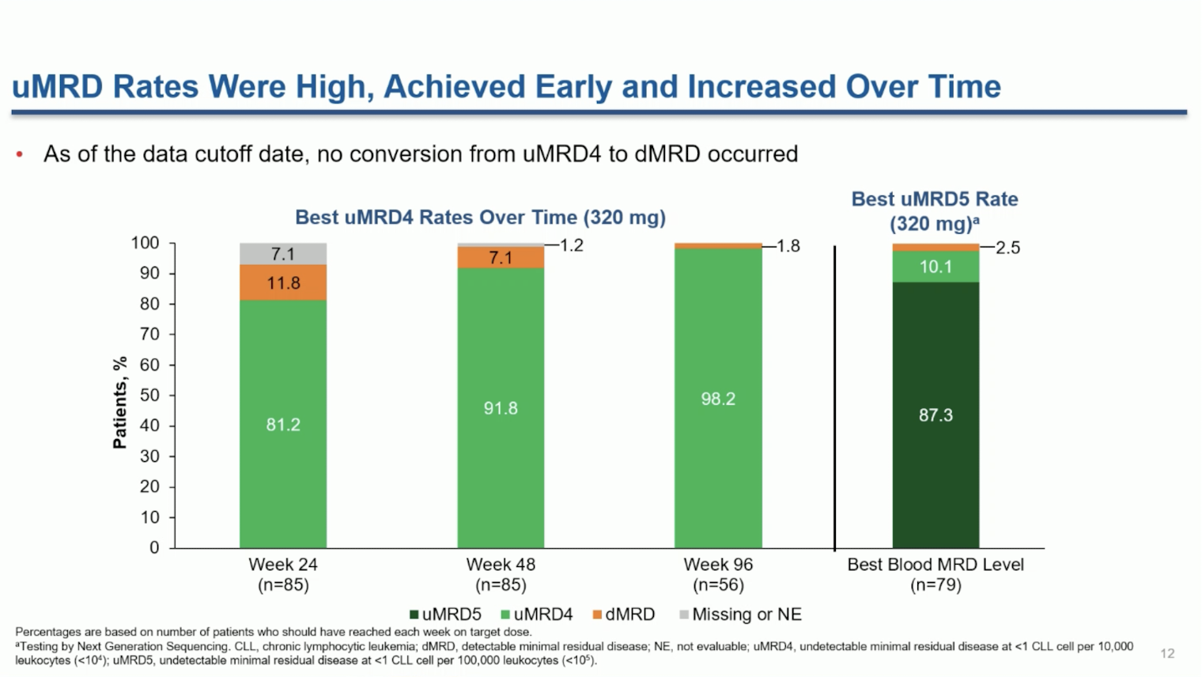

Slide 25
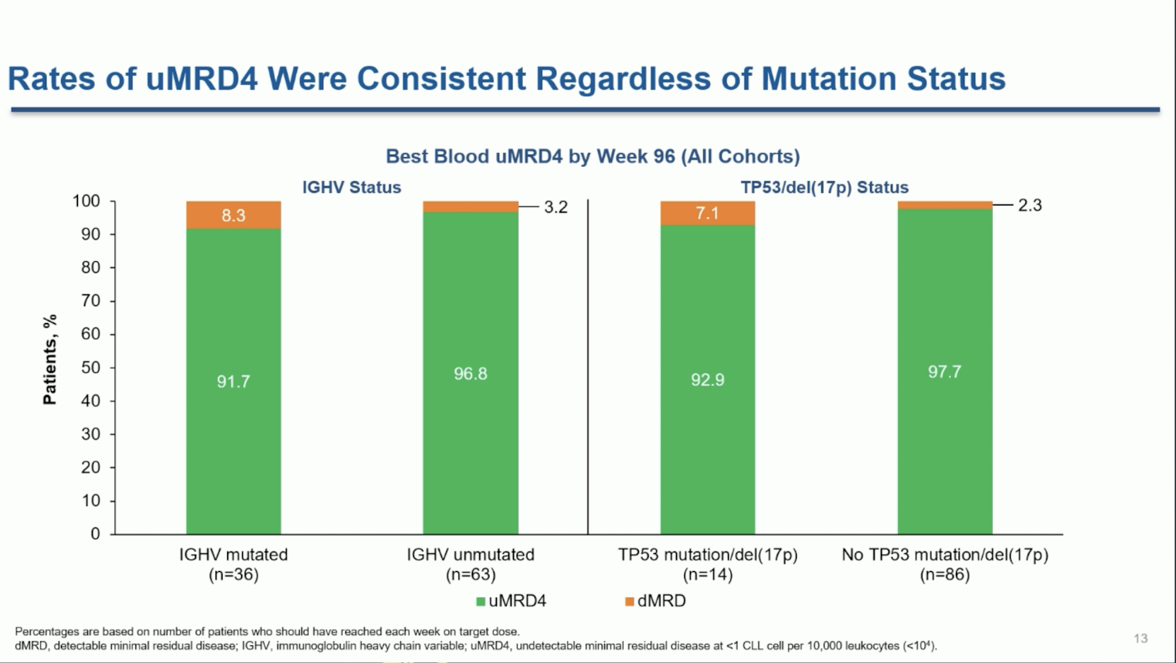

Slide 26
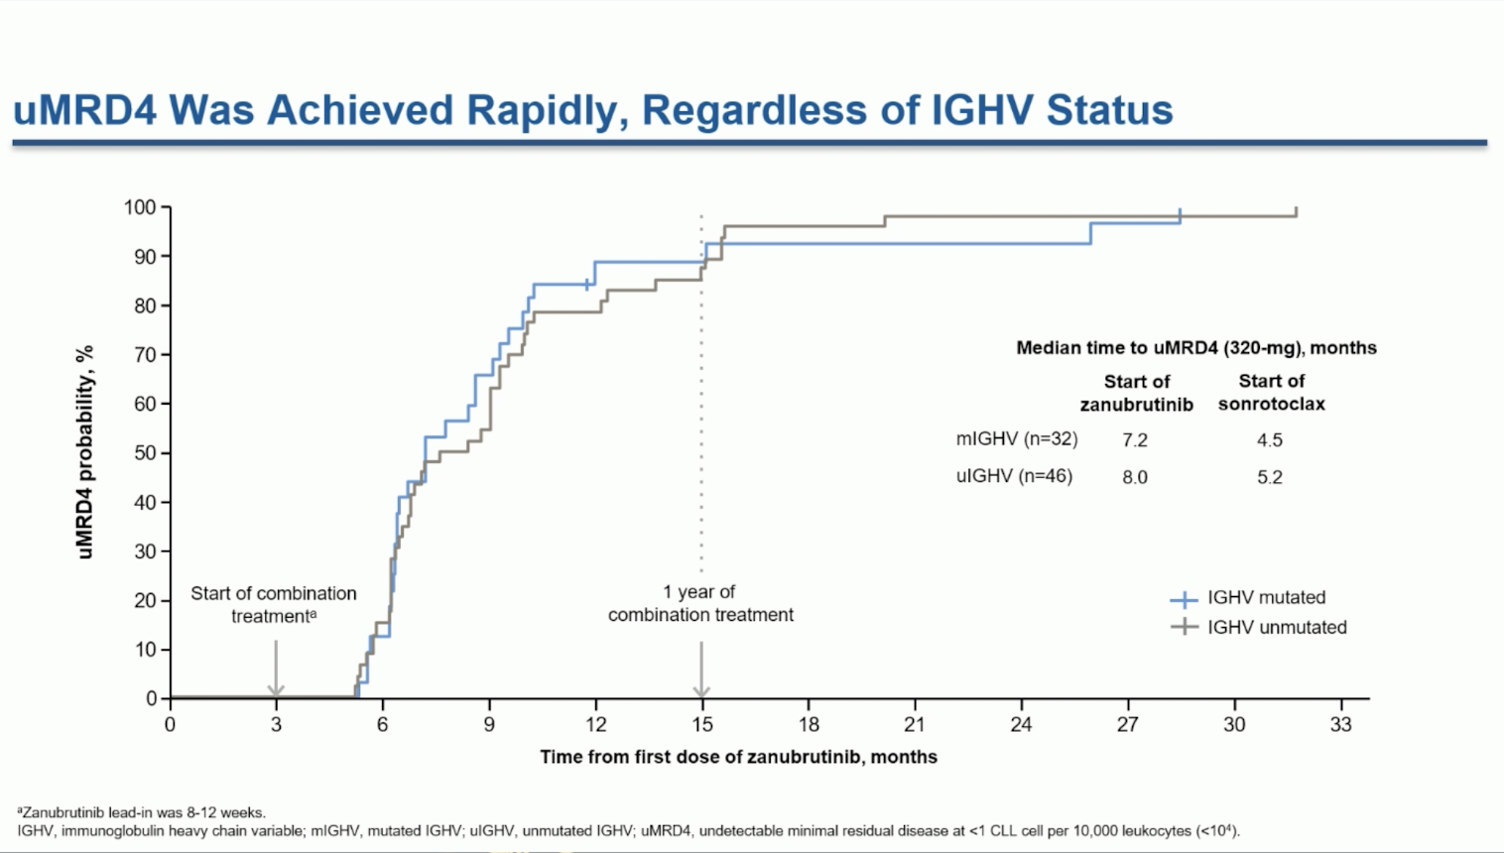

Slide 27
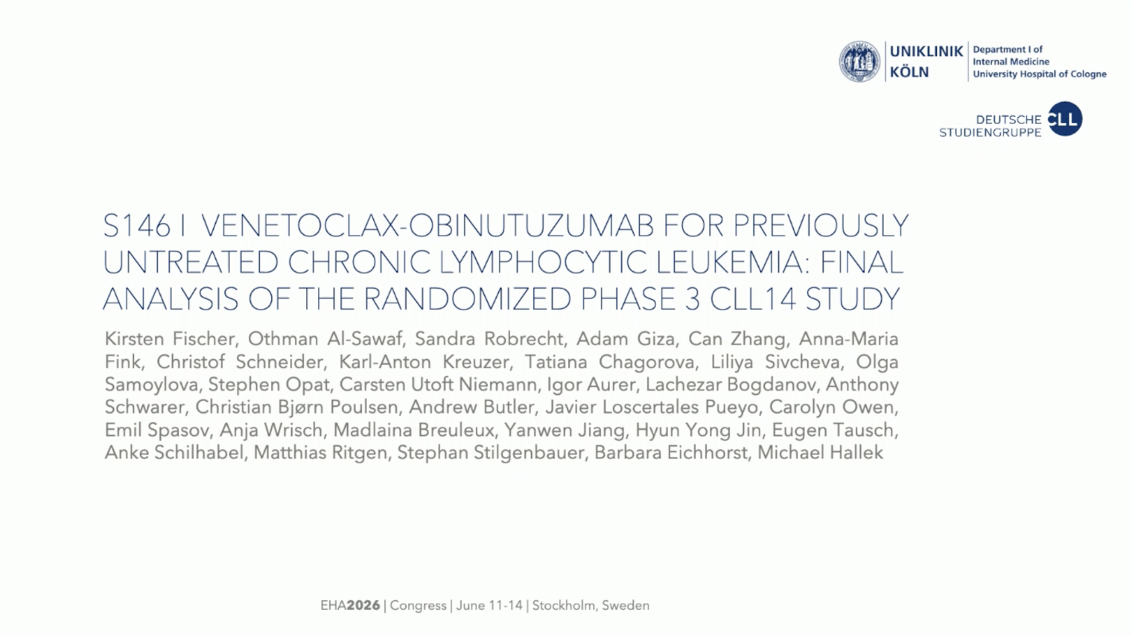

Slide 28
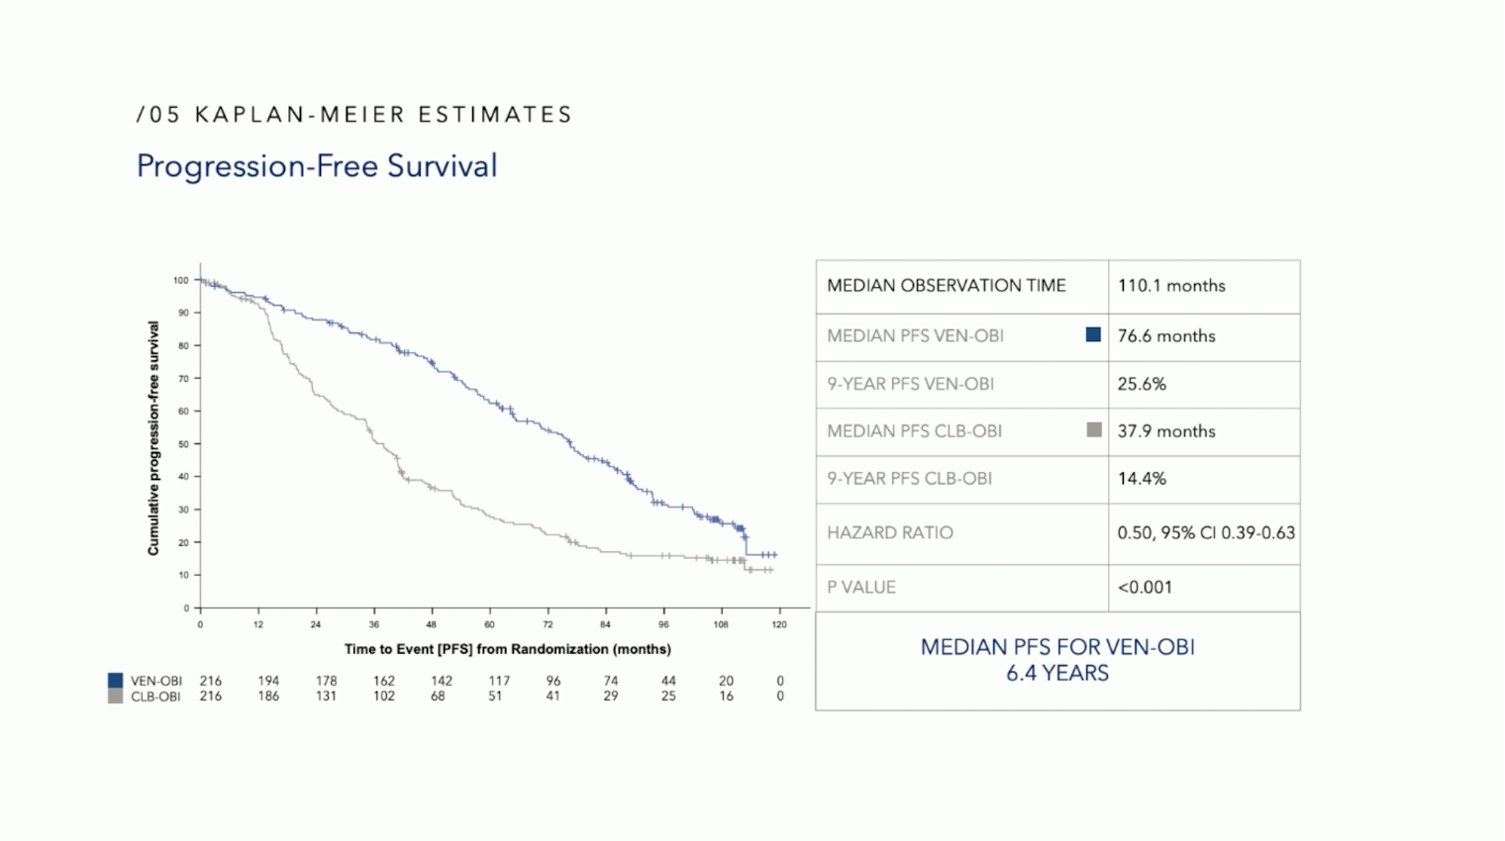

Slide 29
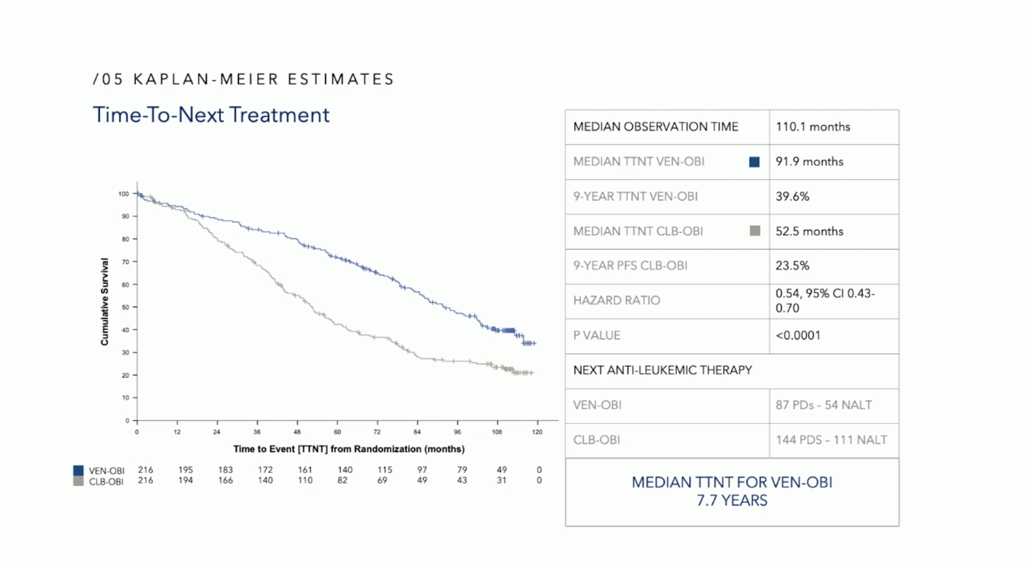

Slide 30
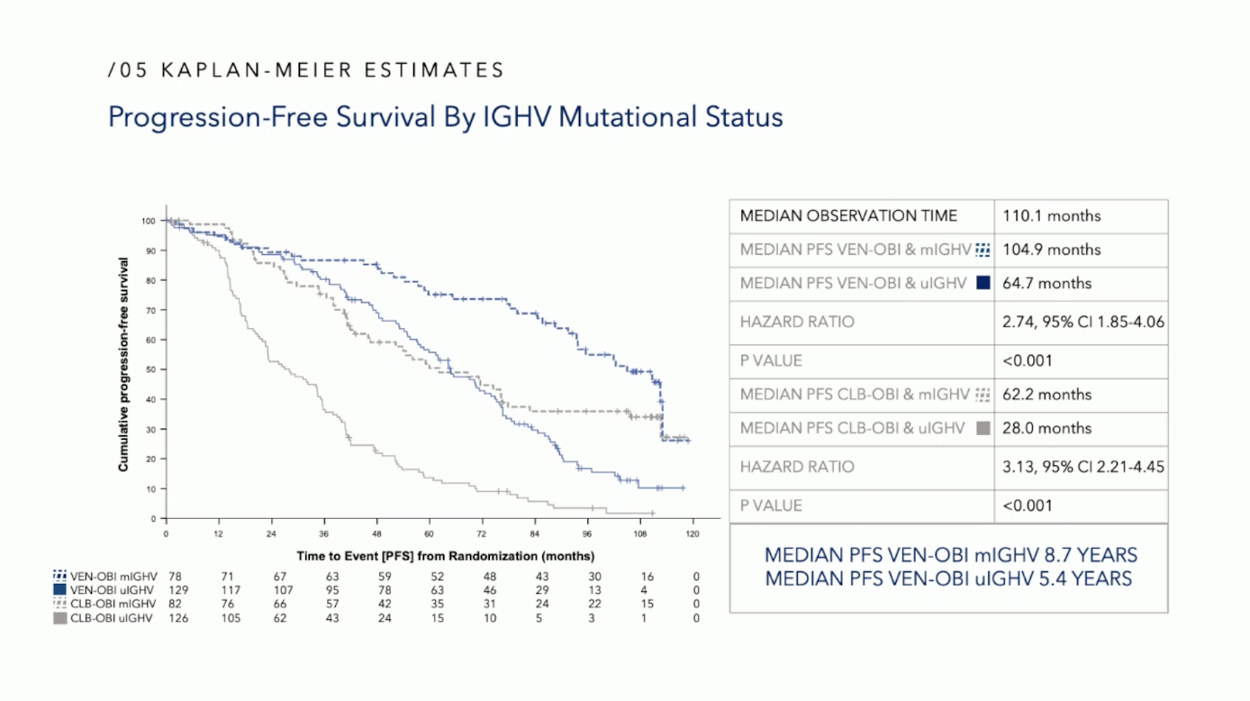

Slide 31
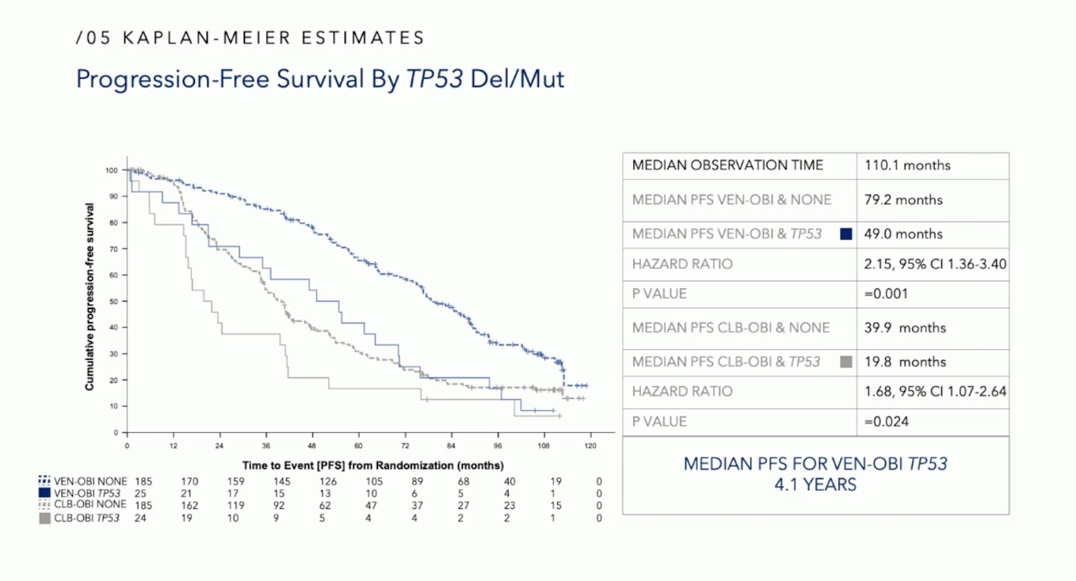

Slide 32
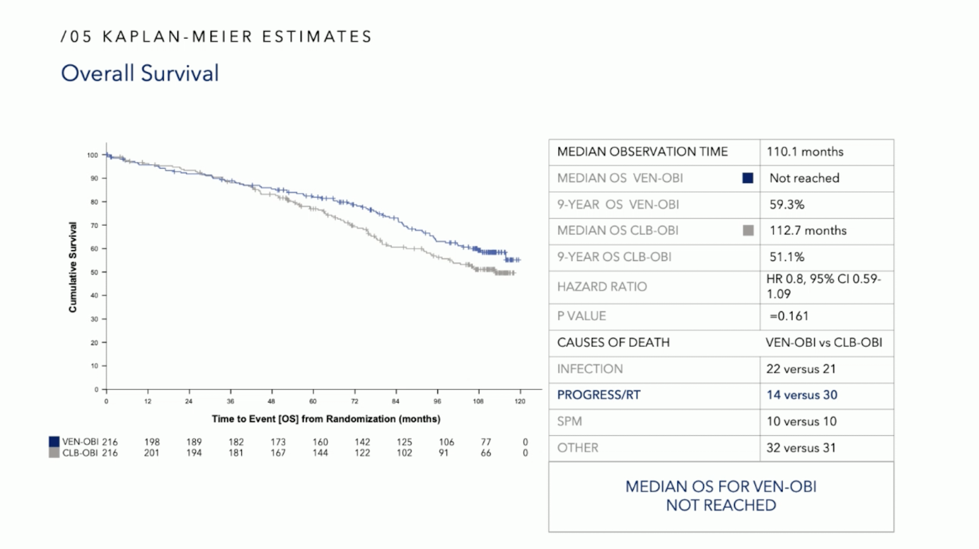

Slide 33
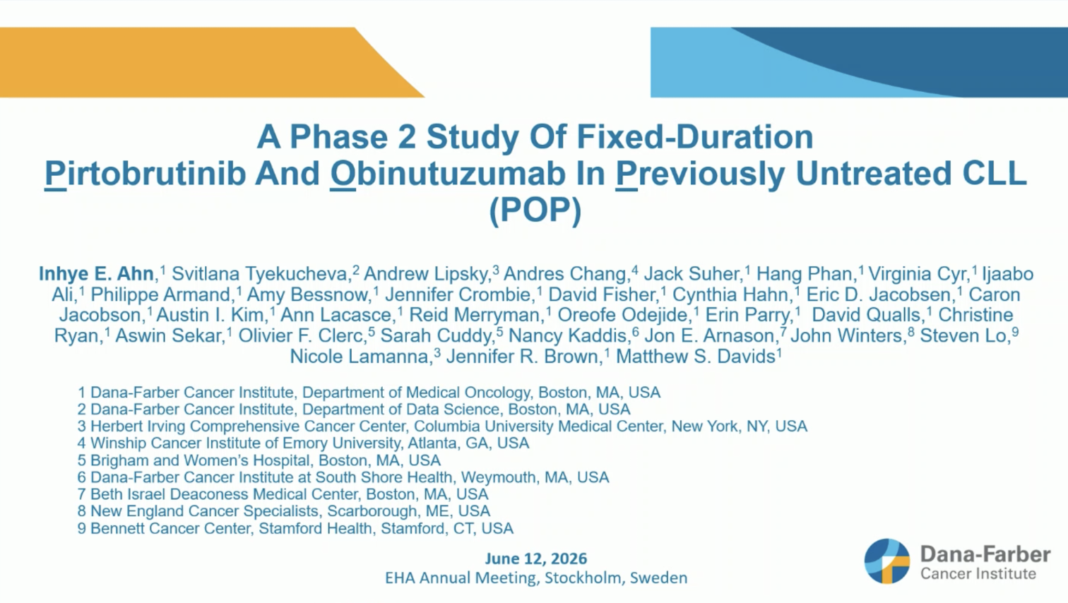

Slide 34
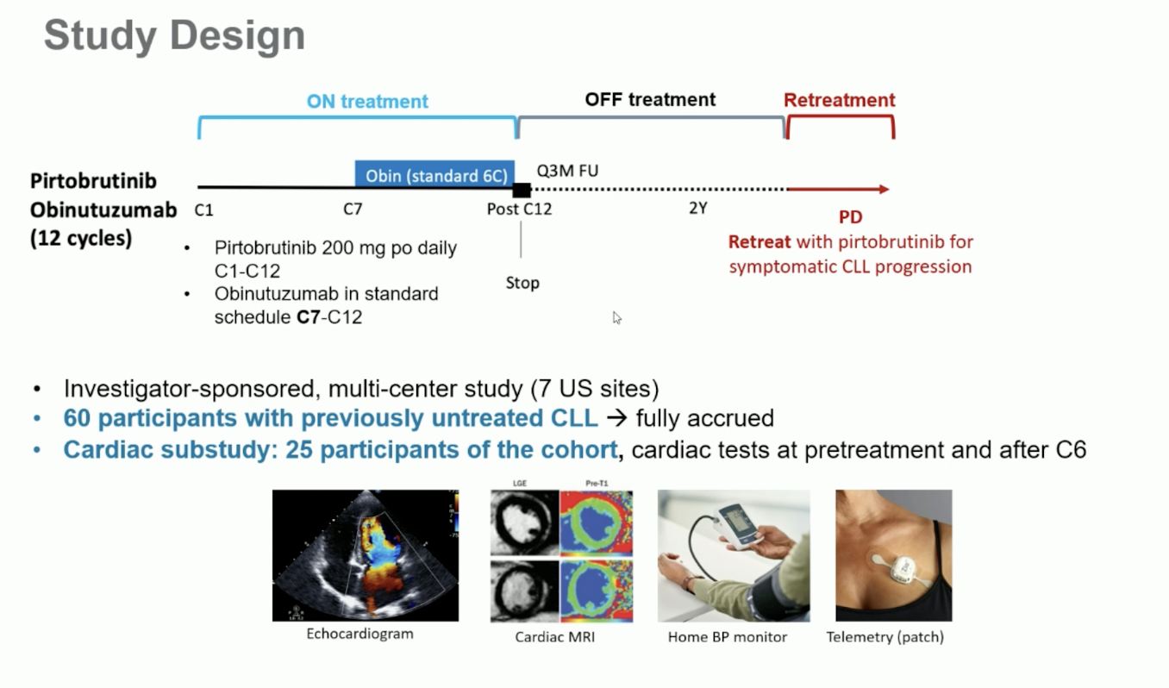

Slide 35
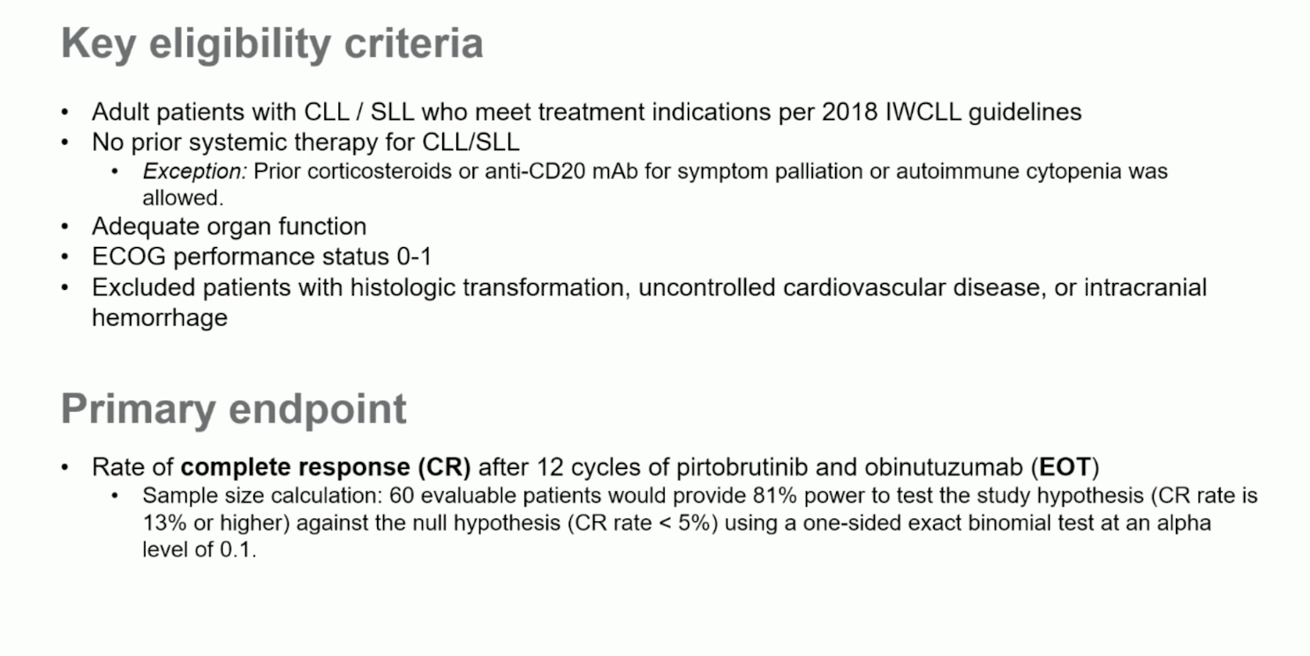

Slide 36
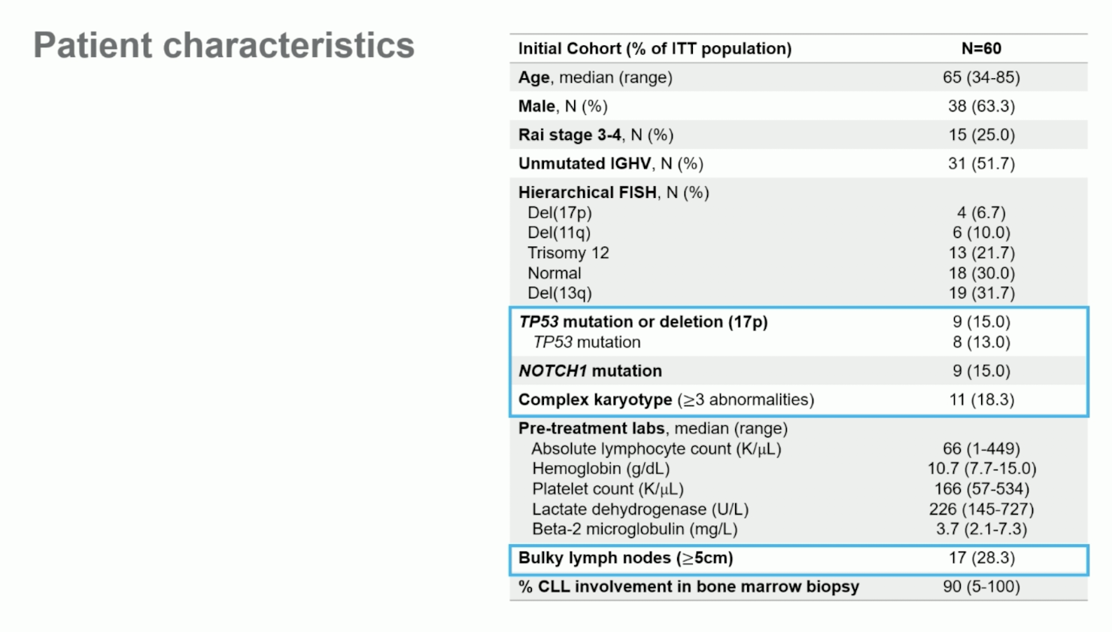

Slide 37
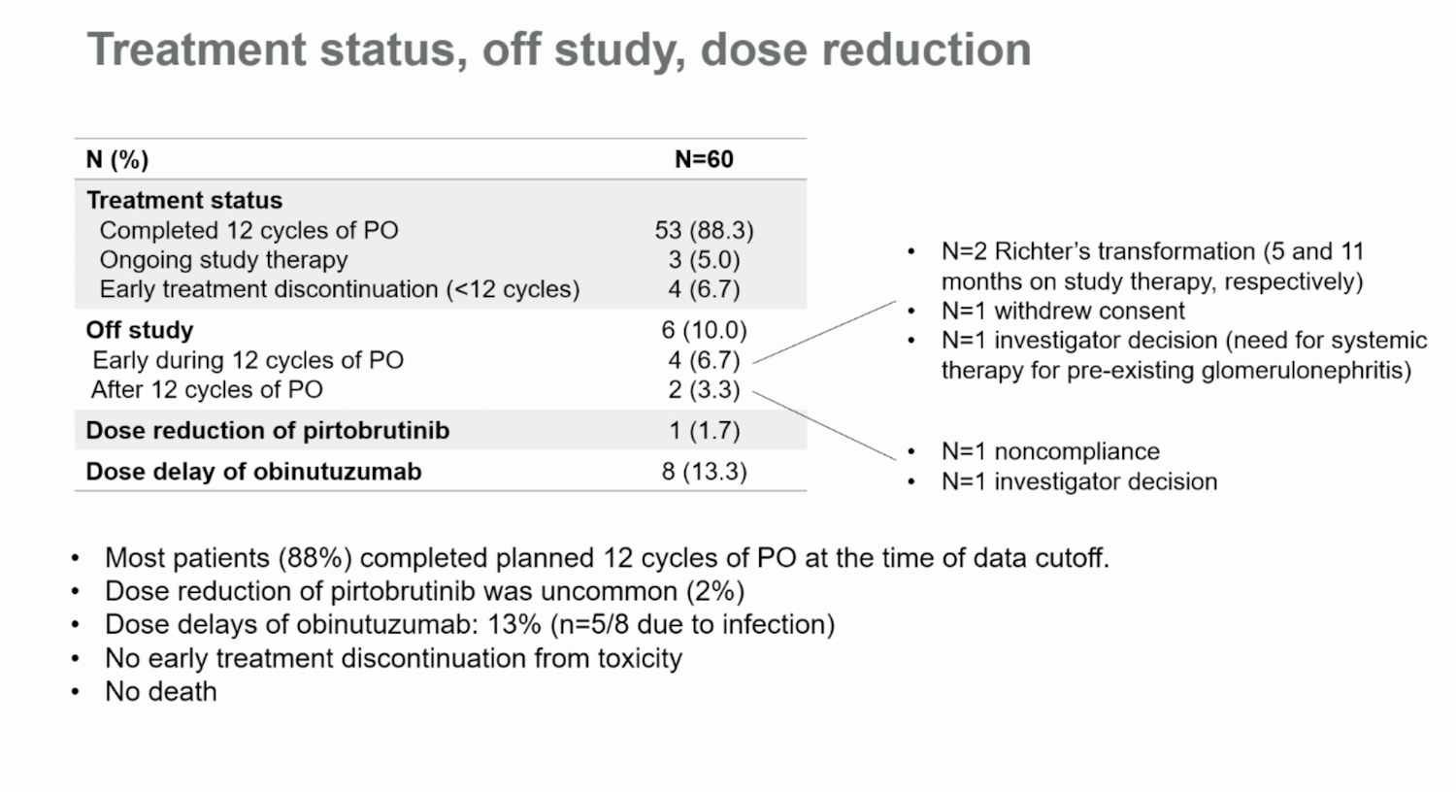

Slide 38
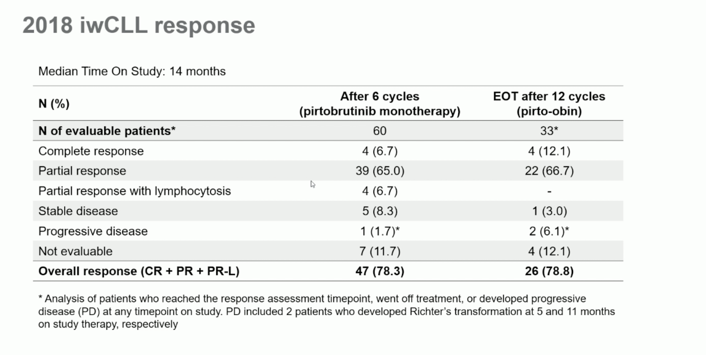

Slide 39
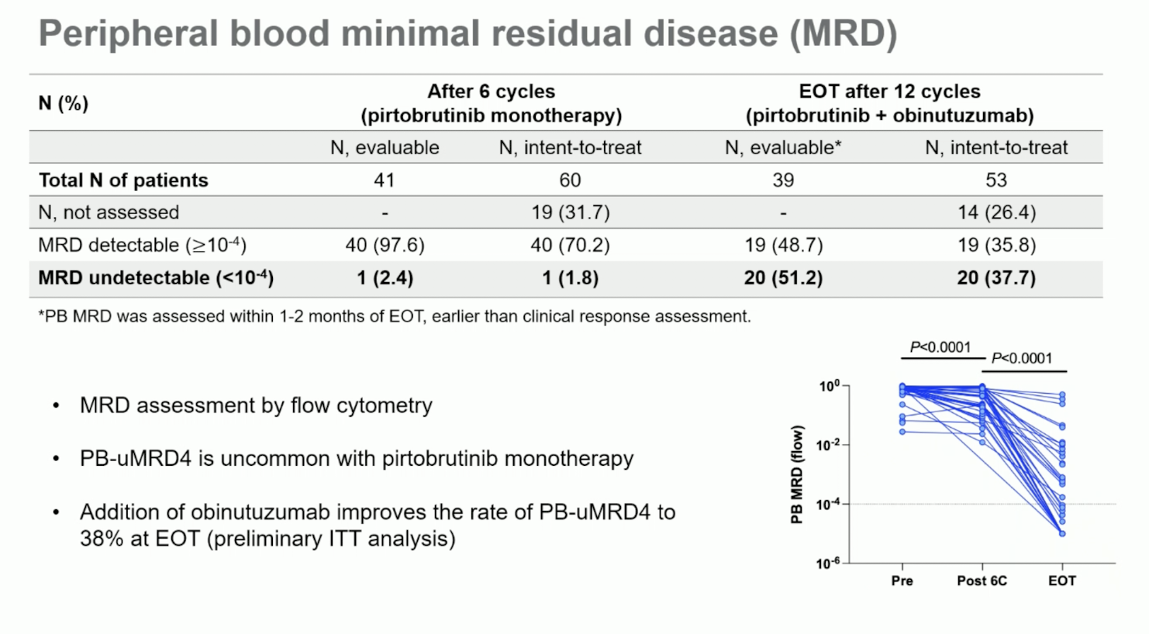

Slide 40
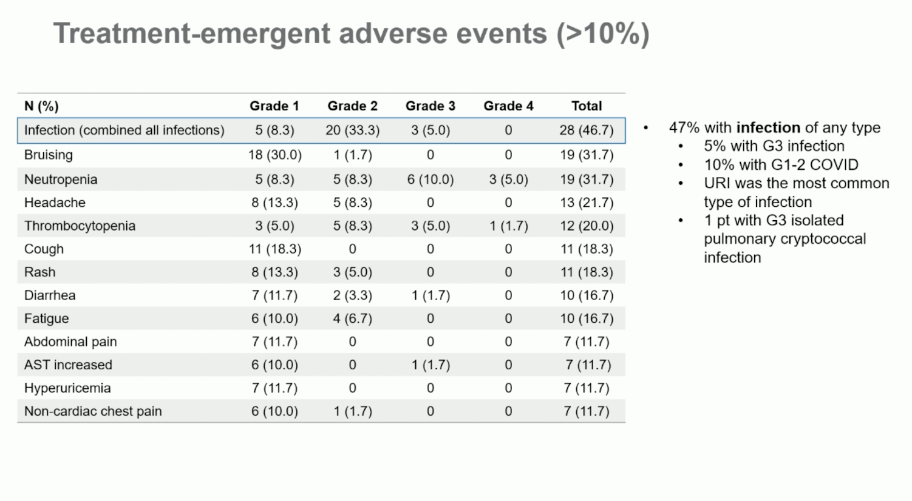

Slide 41
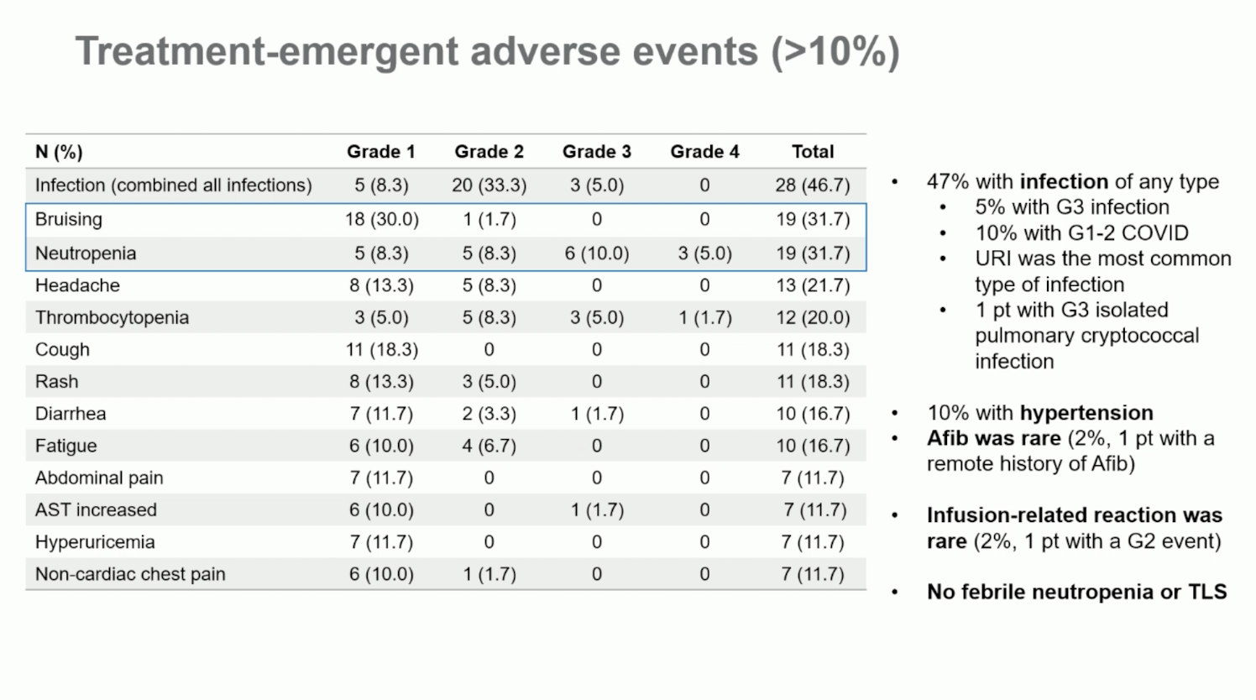

Slide 42
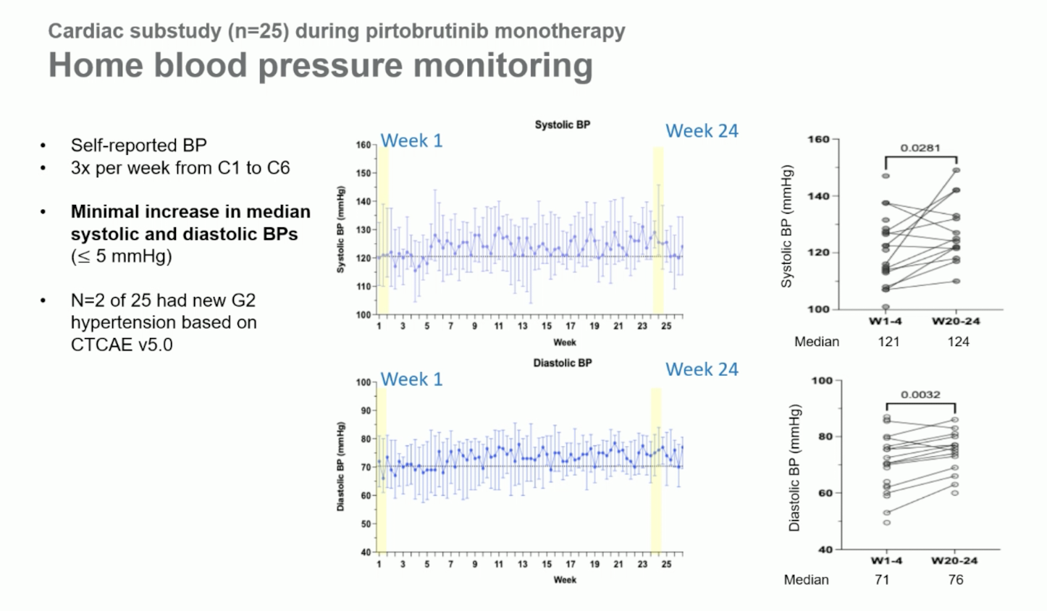

Slide 43
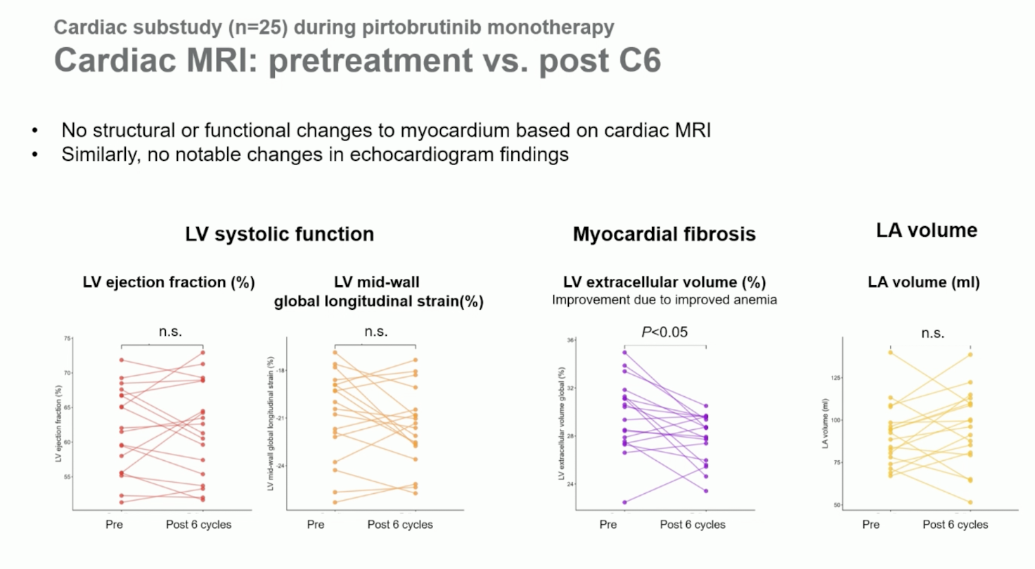

Slide 44
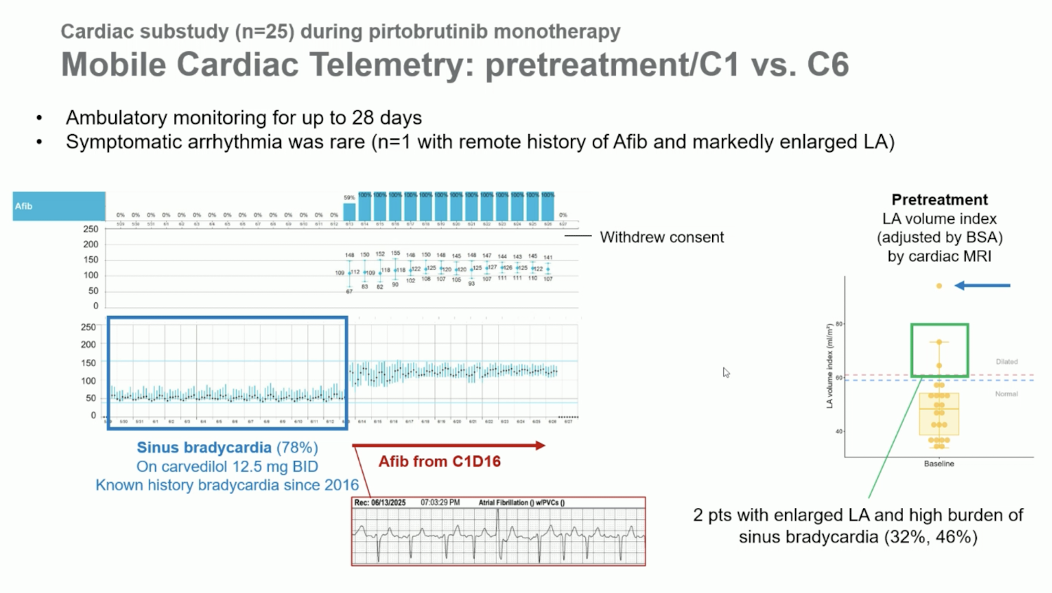

Slide 45
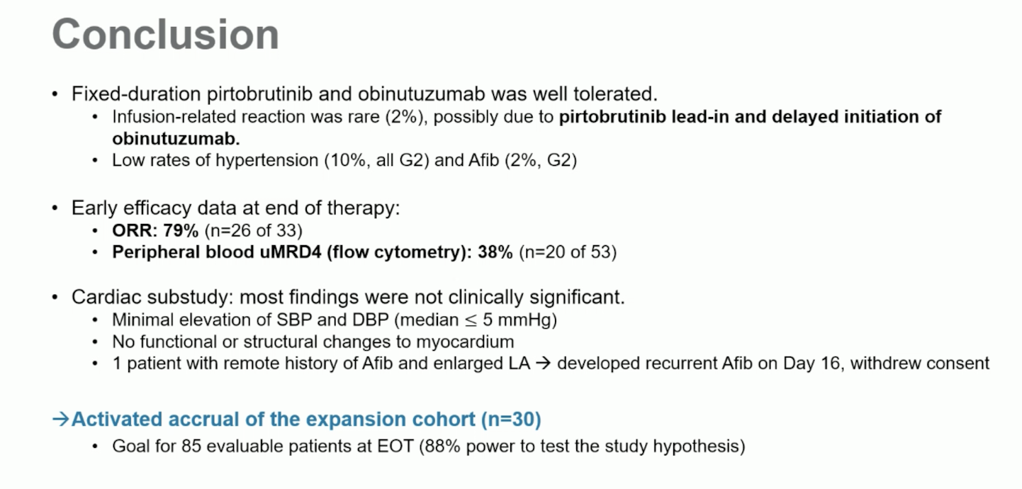

Slide 46
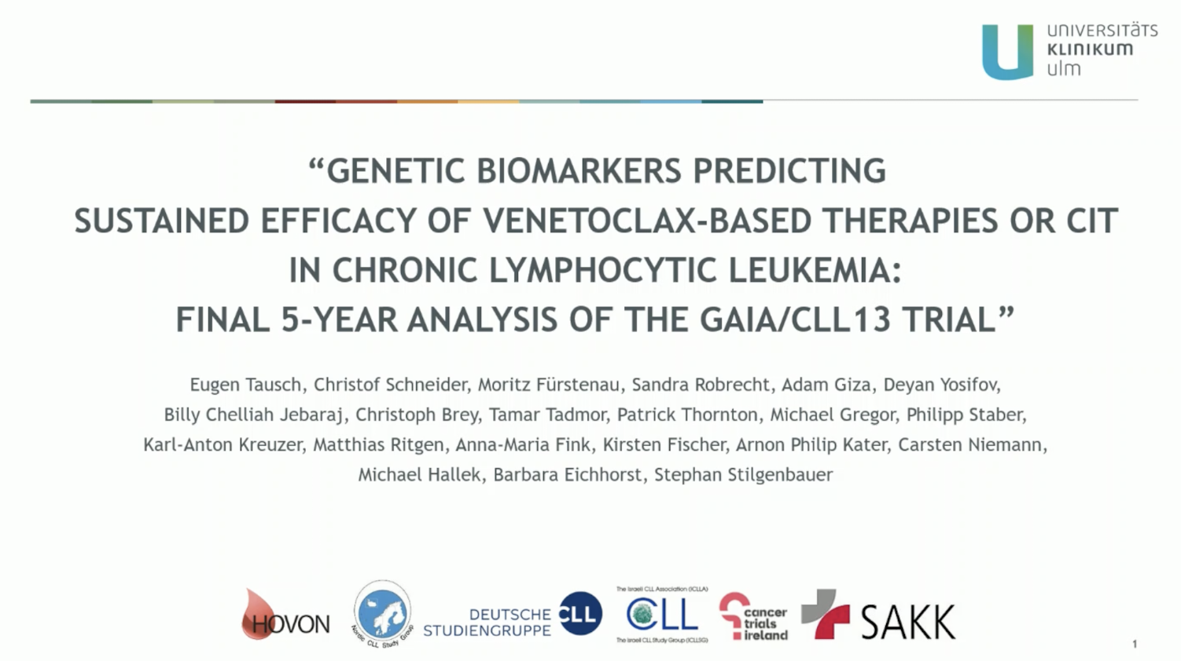

Slide 47
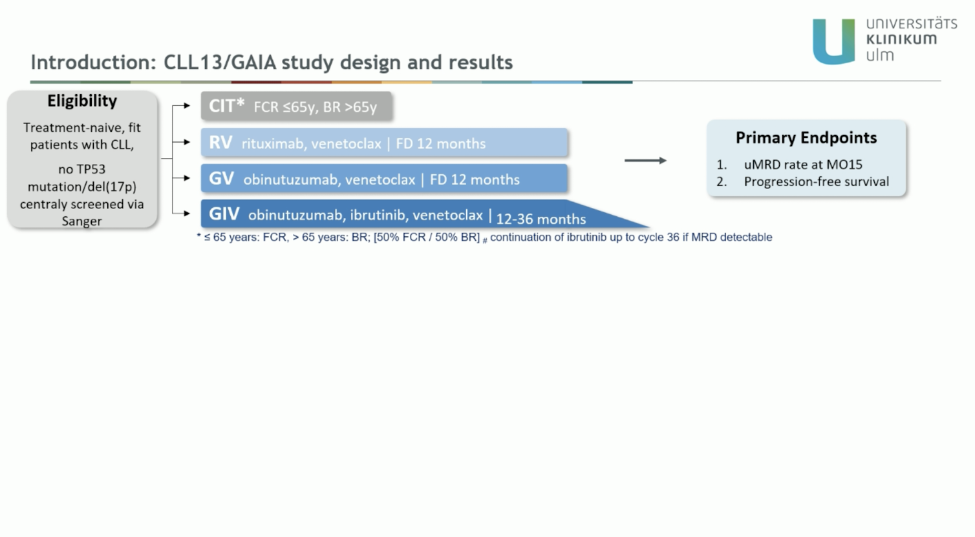

Slide 48
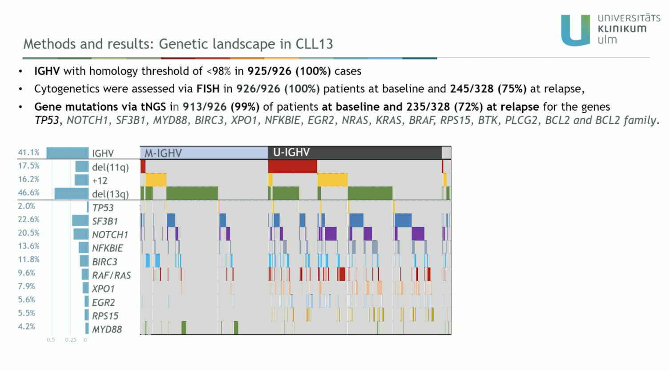

Slide 49
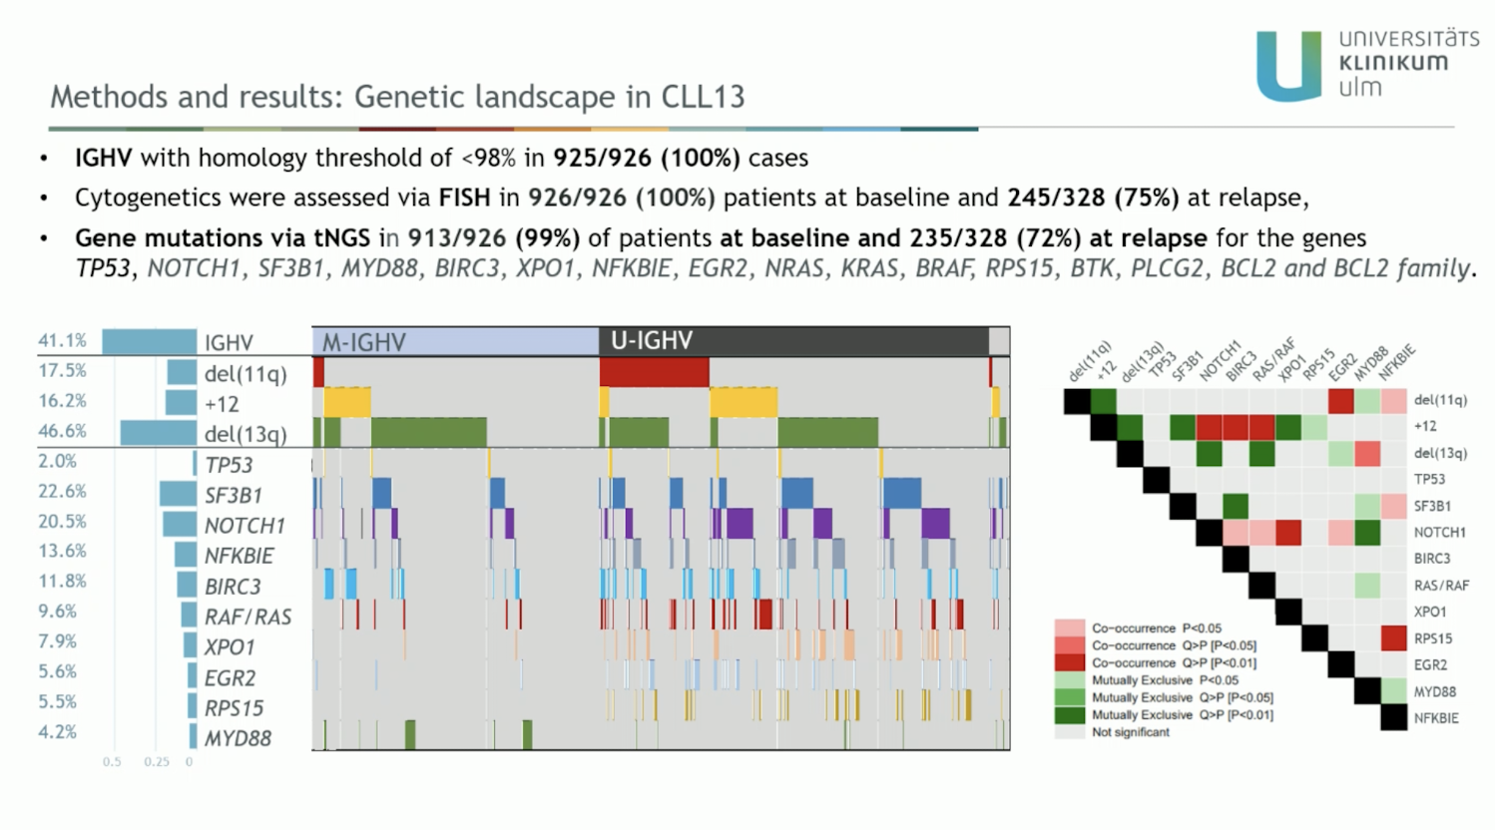

Slide 50
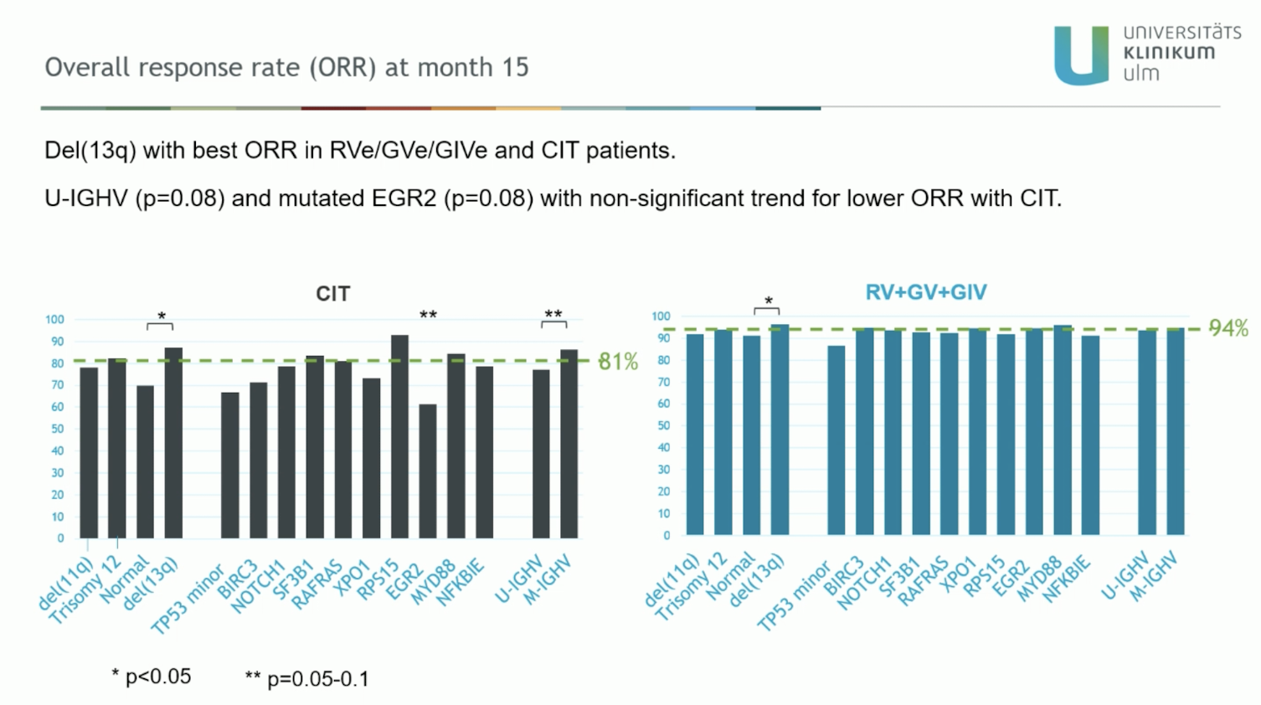

Slide 51
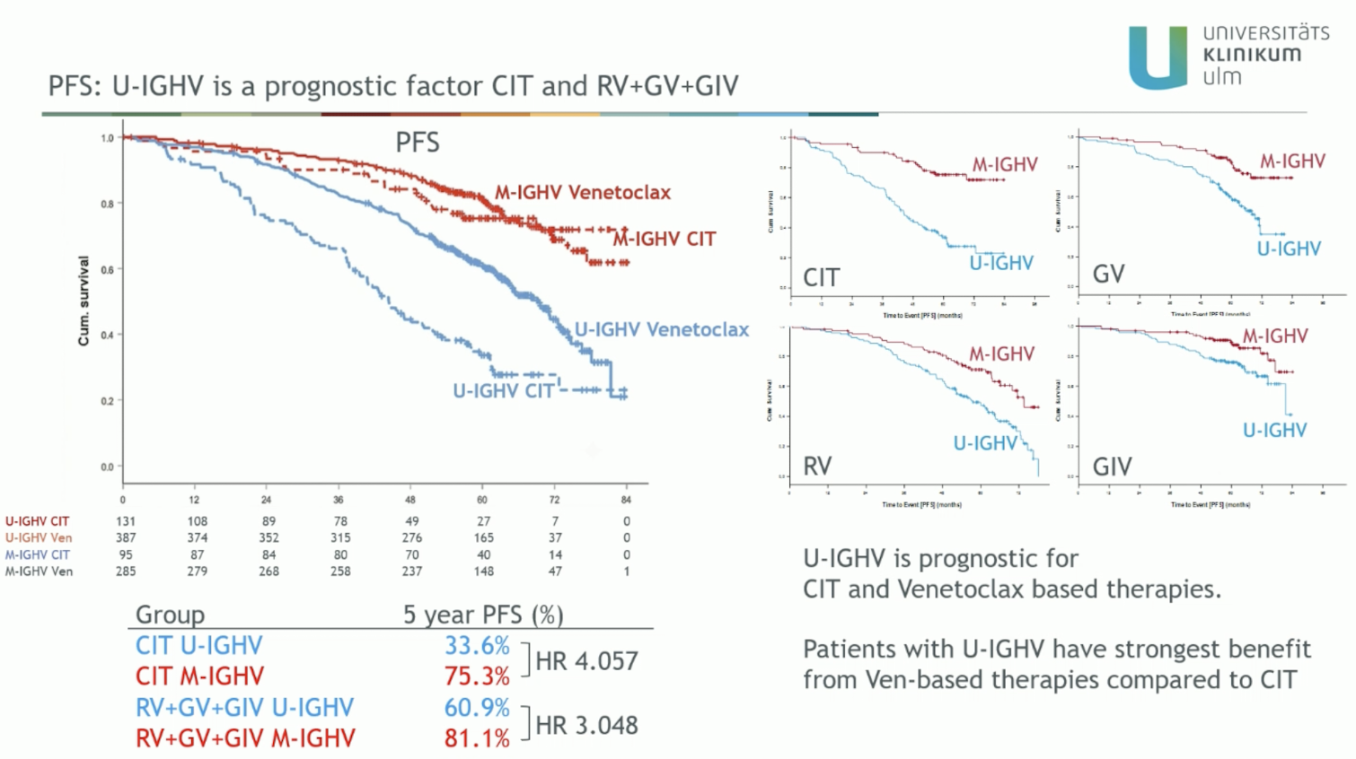

Slide 52
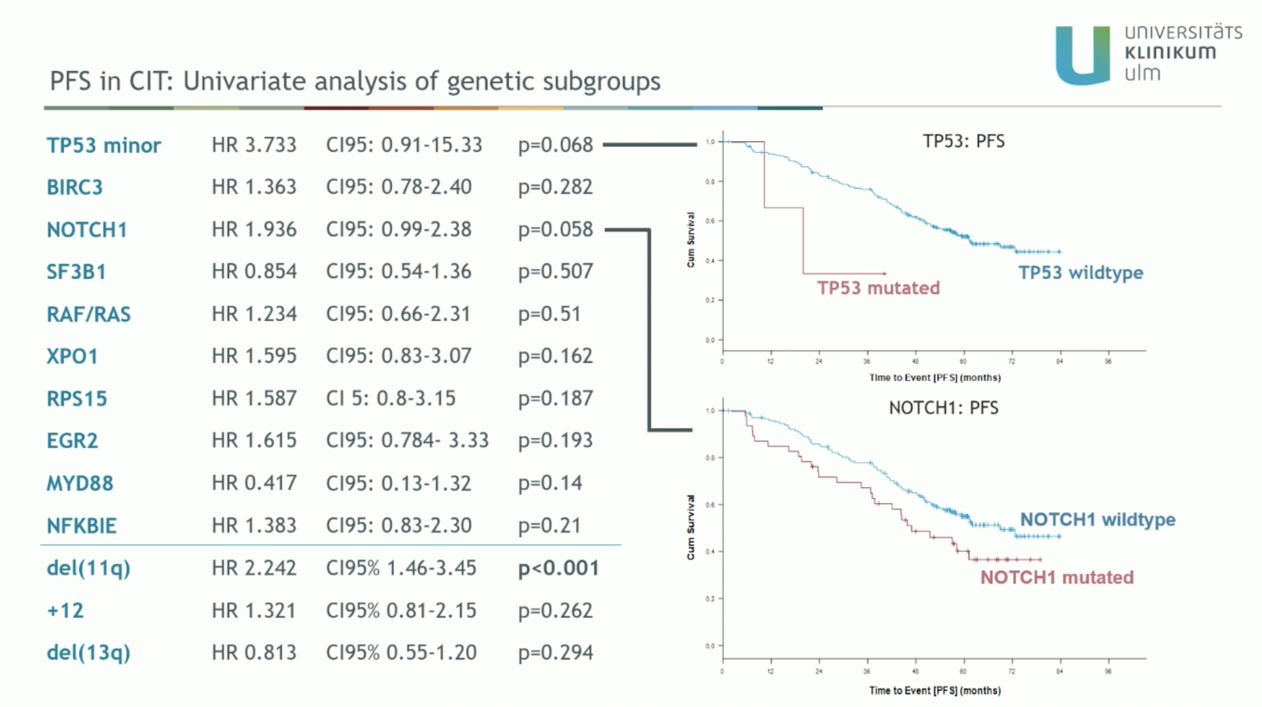

Slide 53
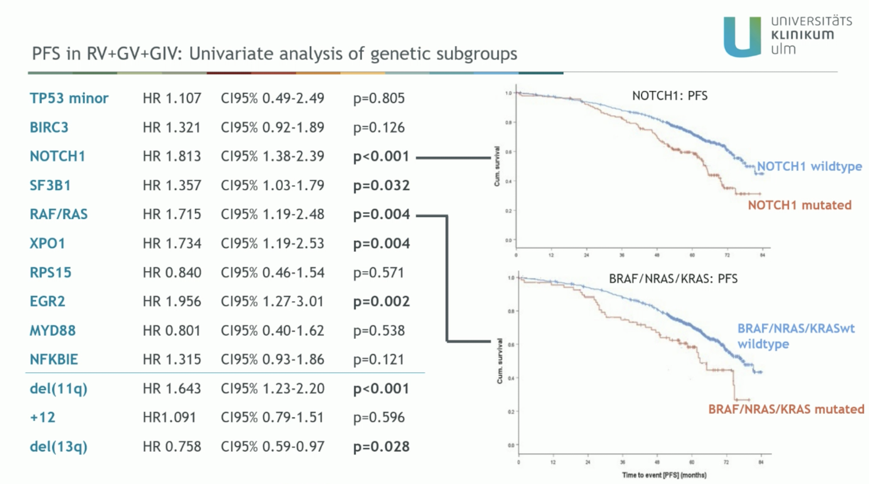

Slide 54
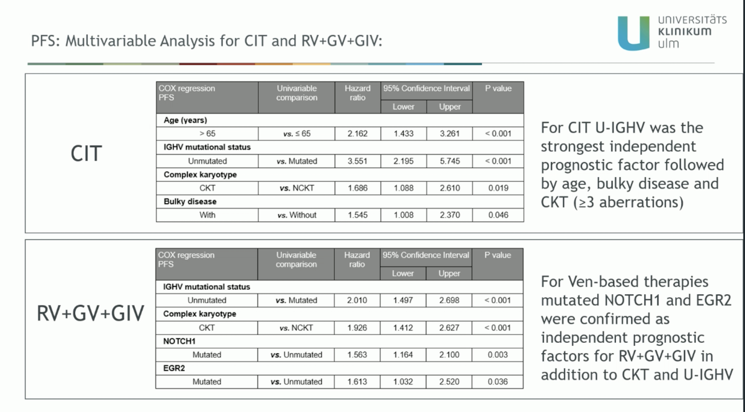

Slide 55


Slide 56


Slide 57


Slide 58


Slide 59


Slide 60


Slide 61


Slide 62


Slide 63


Slide 64


Slide 65


Slide 66


Slide 67


Slide 68


Slide 69


Slide 70


Slide 71


Slide 72


Slide 73


Slide 74


Slide 75


Slide 76


Slide 77


Slide 78


Slide 79


Slide 80


Slide 81


Slide 82


Slide 83


Slide 84


Slide 85


Slide 86


Slide 87


Slide 88


Slide 89


Slide 90


Slide 91


Slide 92


Slide 93


Slide 94


Slide 95


Slide 96


Slide 97


Slide 98


Slide 99


Slide 100


Slide 101


Slide 102


Slide 103


Slide 104


Slide 105


Slide 106


Slide 107


Slide 108


Slide 109


Slide 110


Slide 111


Slide 112


Slide 113


Slide 114


Slide 115


Slide 116


Slide 117


Slide 118


Slide 119


Slide 120


Slide 121


Slide 122


Slide 123


Slide 124


Slide 125


Slide 126


Slide 127


Slide 128


Slide 129


Slide 130


Slide 131
Poster presentations

Slide 132
PF598
ASSURE — Acalabrutinib Monotherapy: Final Phase 3b Results
N = 552
Opat S, et al. | TN, R/R, and Ibr-Intolerant CLL | NCT04008706 | Median follow-up 51.9 mo
82%
NR
86%
54.3 mo
58%
ORR
(TN cohort)
Median DOR
(TN)
PFS at 42 mo
(TN)
Median follow-up
(TN cohort)
Completed full
treatment (48 cycles)
EFFICACY OUTCOMES BY COHORT
SAFETY HIGHLIGHTS
Endpoint
TN (n=310)
R/R (n=202)
Ibr-intol (n=40)
TEAEs ≥20%: COVID-19 (46%), headache, diarrhea, contusion, arthralgia
Grade ≥3 TEAEs: 22% (TN), 18% (R/R), 29% (Ibr-intol), 23% (overall)
TEAEs leading to discontin. ≥1%: COVID-19 (4%), COVID-19 pneumonia (2%)
No new safety signals after >4 years of follow-up
ORR
82%
76%
55%
Median DOR
NR
47.2 mo
33.3 mo
PFS at 42 months
86%
66%
51%
Median follow-up
54.3 mo
45.8 mo
31.6 mo
Median exposure
54.3 mo
44.7 mo
30.6 mo
Discontinued treatment
36%
48%
63%
CONCLUSIONS
Safety profile of acalabrutinib maintained with >4 years of follow-up across TN, R/R, and Ibr-intol patients
PFS (≥2 mo estimates): Overall 77%; TN 86%; R/R 66%; Ibr-intol 61% — consistent with ELEVATE-RR and other covalent BTKi data
At 42 months, 77% of patients remained free of disease progression or death
Results support acalabrutinib treat-to-progression regimen as safe, effective, and applicable in real-world settings

Slide 133
PS1689
BOVen-ΔMRD400 — MRD-Guided Zanubrutinib + Obinutuzumab + Venetoclax
N = 79
Soumerai J, et al. | Treatment-Naïve CLL | Multi-center Phase 2 | MSK, Mass General Brigham, Northwestern
100%
83%
73%
10 mo
60%
ORR (PR or CR)
All patients
Blood uMRD4
at 10–12 months
Blood uMRD5
at 10–12 months
Median treatment
duration (ΔMRD400 achievers)
ΔMRD400
achievers
ΔMRD400 ACHIEVERS vs NON-ACHIEVERS
SAFETY HIGHLIGHTS
Outcome
ΔMRD400 Achievers (n=47)
Non-Achievers (n=31)
Well-tolerated; no Grade 5 AEs occurred on study
1 case of laboratory TLS on cycle 1 day 1 (obinutuzumab-zanubrutinib)
No febrile neutropenia reported
All COVID-19 cases were Grade 1–2
Key AEs ≥20%: neutropenia (58%), diarrhea (53%), platelet decrease (48%), bruising (46%)
Grade ≥3 neutropenia: 43.8%; Grade ≥3 hypertension: 8.9%
Time on therapy (median)
8 months
13 months
EOT blood uMRD4 (10 mo)
100% (47/47)
57% (17/30)
EOT blood uMRD5 (10 mo)
94% (44/47)
39% (11/28)
BM uMRD4 at C10D28
69% (29/42)
30% (9/30)
BM uMRD5 at C10D28
44% (17/42)
17% (5/30)
MRD-free survival (median)
51 months
23 months
HR for MRD-free survival
HR 4.95 (95% CI 1.5–14.1)
Ref — p<0.001
CONCLUSIONS
BOVen with MRD-kinetics-guided duration is well-tolerated and achieved high rates of uMRD4 (83%) and uMRD5 (73%) within 10–12 months in a high-risk cohort
Prospective validation confirms: ΔMRD400 identifies patients with significantly higher rates of early blood uMRD4 (100% vs 52%) and uMRD5 (94% vs 36%)
Traditional genomic factors (TP53, IGHV status) were not associated with ΔMRD400 achievement
Additional follow-up needed to determine if extending therapy for ΔMRD400 non-achievers improves uMRD4/uMRD5 rates and translates to outcomes benefit

Slide 134
PF606
TAILOR — Fixed-Duration Dose-Modified Ibrutinib + Venetoclax in TN CLL
N = 171
Chia P, et al. | Previously Untreated CLL | Prospective Phase 2 | NCT03836261 | Benchmark ORR 75%
94.2%
89.4%
98.8%
4.7%
11.8%
ORR — Cohort 1A
(reactive dose adjust.)
ORR — Cohort 1B
(proactive dose adjust.)
12-month PFS
both cohorts
Ibr discontin.
due to AEs (1A)
Ibr discontin.
due to AEs (1B)
COHORT COMPARISON: REACTIVE (1A) vs PROACTIVE (1B) DOSE ADJUSTMENT
SAFETY HIGHLIGHTS
Endpoint
Cohort 1A — Reactive (n=86)
Cohort 1B — Proactive (n=85)
Both cohorts: AEs leading to Ibr dose reduction were manageable
COVID-19-related AEs: leading cause of AE-related discontinuations in both cohorts
Cardiac events (atrial fibrillation): low rates in both cohorts; no cardiac deaths
Proactive cohort: grade ≥3 AEs similar across age groups despite dose adjustments
No ventricular arrhythmias in either cohort
Primary endpoint (ORR)
94.2% (95% CI 87–98%)
89.4% (95% CI 81–95%)
Met benchmark (ORR >75%)?
Yes — statistically significant
Yes — statistically significant
12-month PFS
98.8%
97.6% / 98.8%
Ibr discontin. due to AEs
4.7%
11.8%
AE leading to Ibr dose reduction
Not captured (reactive only)
Proactive: reduced per protocol
Dose reductions occurred in
—
Higher proportion ≥65 yrs group
Deaths on study
1 (intracranial hemorrhage, Ibr-related)
1 (pneumonia, unrelated to Ibr)
CONCLUSIONS
Both reactive and proactive Ibr+Ven dose adjustment cohorts met the primary endpoint (ORR >75% benchmark) with statistically significant improvement
12-month PFS was 98.8% in both cohorts, supporting treatment efficacy across dose adjustment strategies
Proactive dose reductions improved AE profiles including low rates of atrial fibrillation and no cardiac deaths
Results further support the safety and dosing flexibility of FD Ibr+Ven in previously untreated CLL

Slide 135
PF614
AMPLIFY Post-Hoc — Acalabrutinib+Venetoclax ± Obinutuzumab by Age Subgroup
N = 585
Seymour JF, et al. | TN CLL | Phase 3 AMPLIFY (NCT03836261) | AV (n=291) vs AVO (n=294) vs CIT
AV & AVO
<65 / ≥65
No
COVID-19
Modest ↑
Both regimens showed
PFS benefit vs CIT
Similar within-treatment
safety profiles by age
New safety signals
identified
Leading cause of AE-related
discontinuations all groups
AE discontinuations
in ≥65 vs <65
PFS BENEFIT vs CIT — BY AGE SUBGROUP (Hazard Ratios)
SAFETY BY AGE
Comparison
Age <65 — HR (95% CI)
Age ≥65 — HR (95% CI)
Similar within-treatment safety profiles across <65 and ≥65 age groups
≥65 years: modest increase in AE-related discontinuations vs <65
COVID-19 AEs: most common reason for discontinuation across all groups
≥65 at baseline: higher proportion with reduced creatinine clearance, anemia, higher CV comorbidity scores
No new safety signals in either age subgroup
AV vs CIT
0.64 (0.58–1.22)
0.42 (0.27–0.64) — favors AV
AVO vs CIT
0.47 (0.35–0.64)
0.47 (0.29–0.78) — favors AVO
AV vs CIT OS
HR 0.94 (0.65–1.22)
HR 0.42 (0.27–0.64)
AVO vs CIT OS
HR 0.47 (0.28–0.79)
HR 0.47 (0.29–0.79)
Median follow-up (AV)
40.5 mo (<65); 42.3 mo (≥65)
42.3 mo
Median follow-up (AVO)
41.1 mo (<65); 42 mo (≥65)
42 mo
Baseline: ≥65 more comorbidities?
—
Yes — higher CrCl reduction, anemia, CV meds
CONCLUSIONS
Fixed-duration AV-containing regimens (AV and AVO) showed PFS benefit vs CIT in both age subgroups (<65 and ≥65 years)
Within-treatment safety profiles were generally similar across age groups; modest increase in AE-related discontinuations observed in ≥65 patients
COVID-19-related AEs were the leading cause of AE-related discontinuations — a consistent finding across age groups and treatment arms
No new safety signals identified — supports use of fixed-duration AV ± obinutuzumab in older patients with TN CLL

Slide 136
PS1701
Pirtobrutinib in TN CLL/SLL — Pooled Results from BRUIN CLL-313 & CLL-314
N = 253
Wierda WG, et al. | Treatment-Naïve CLL/SLL | Pirtobrutinib 200 mg PO QD | Sponsored by Eli Lilly
93.3%
93.2%
97.5%
4.8%
32.7 mo
Pooled ORR
(95% CI 89.1–96.4%)
24-month PFS
(pooled)
24-month OS
(pooled)
Discontinuation
due to TEAEs
Median follow-up
(BRUIN CLL-313)
EFFICACY OUTCOMES BY STUDY
SAFETY HIGHLIGHTS
Endpoint
BRUIN CLL-313 (n=141)
BRUIN CLL-314 (n=112)
Pooled (n=253)
AEs ≥10%: COVID-19 (20.6%), upper respiratory infection (17.1%), neutropenia (14.3%), arthralgia (11.1%), bruising (10.7%)
Hypertension any-grade: 10.7%
Atrial fibrillation/flutter: 2.8%
Major hemorrhage: 0.4%
Low rate of Grade ≥3 events overall; TEAEs leading to discontinuation in 4.8%
Safety profile consistent with prior reports from individual BRUIN studies
ORR (95% CI)
94.3% (89.1–97.5%)
92.0% (85.5–96.3%)
93.3% (89.1–96.4%)
18-month PFS
97.1% (92.8–99.1%)
93.7% (87.4–97.1%)
95.5% (91.9–97.8%)
24-month PFS
94.3% (88.7–97.5%)
87.4% (79.8–92.5%)
93.2%
18-month OS
99.3% (95.0–100%)
98.2% (93.2–99.6%)
98.8% (95.9–99.7%)
24-month OS
99.3%
94.3%
97.5%
Median follow-up
32.7 mo (31.9–33.3)
27.0 mo (26.6–27.4)
~30 mo
Discont. due to TEAEs
—
—
4.8% (1.6% treatment-related)
CONCLUSIONS
Pirtobrutinib demonstrated high efficacy in TN CLL/SLL: ORR 93.3%, 24-month PFS 93.2%, 24-month OS 97.5% — sustained across two RCTs
Safety profile consistent across BRUIN CLL-313 and CLL-314: low rates of Grade ≥3 events, low discontinuation (4.8%) — 1.6% treatment-related
Pooled analysis across 2 independent RCTs strengthens confidence in pirtobrutinib as a frontline BTKi option for CLL/SLL
Hypertension (10.7%), AF/flutter (2.8%), and hemorrhage (2.4%) were manageable; no new safety signals identified

Slide 137
Late-Breaking Abstracts

Slide 138

Notes:
Title Slide - BRUIN CLL-322 (EHA 2026)

Slide 139

Notes:
BRUIN CLL-322 Trial Design

Slide 140

Notes:
Patient Disposition (ITT Population)

Slide 141

Notes:
Patient Demographics & Baseline Characteristics

Slide 142

Notes:
Progression-Free Survival by IRC (ITT Population)

Slide 143

Notes:
Progression-Free Survival by INV (ITT Population)

Slide 144

Notes:
PFS by IRC - Prior cBTKi Subgroups

Slide 145

Notes:
Progression-Free Survival by Subgroup (Demographics)

Slide 146

Notes:
Progression-Free Survival by Subgroup (Prior cBTKi)

Slide 147

Notes:
Overall Response Rate

Slide 148

Notes:
MRD Analysis (clonoSEQ in Peripheral Blood)

Slide 149

Notes:
Time to Next Treatment (ITT Population)

Slide 150

Notes:
Overall Survival (ITT Population)

Slide 151

Notes:
Adverse Events of Interest

Slide 152

Notes:
Treatment-Emergent Adverse Events

Slide 153

Notes:
Conclusions

Slide 154


Slide 155


Slide 156





Obrigado!
¡Gracias!
celsoarrais@gmail.com
celso.arrais@unifesp.br
X: @ArraisCelso

